Slide 1

MALDIVES ASSOCIATION OF SURGEONS
A Decade of Surgical Excellence
(2014 – 2024)

Slide 2
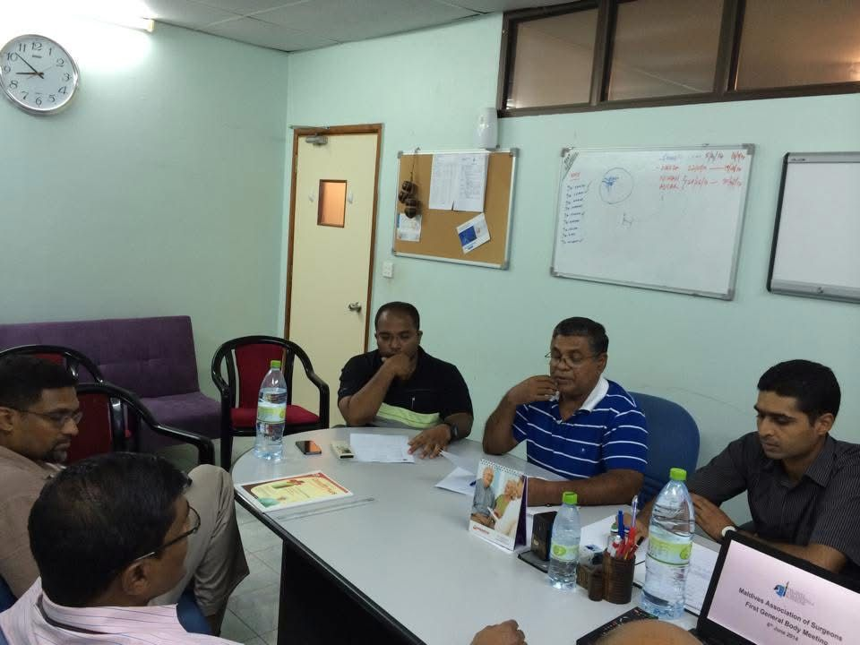
BEGINING
Maldivian surgical community grown over last few decades and there was interest to establish an association for them to work on organize their activities and unite them in one umbrella.

Slide 3
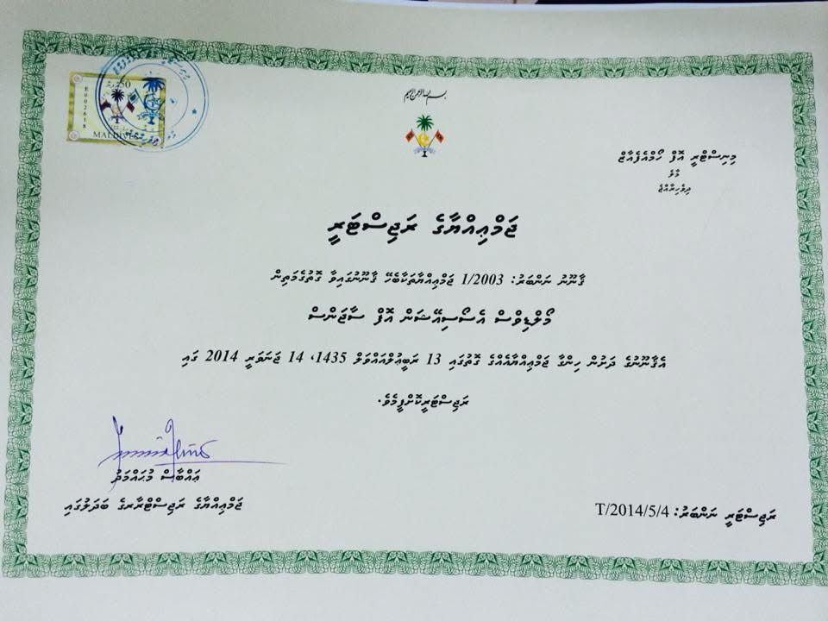
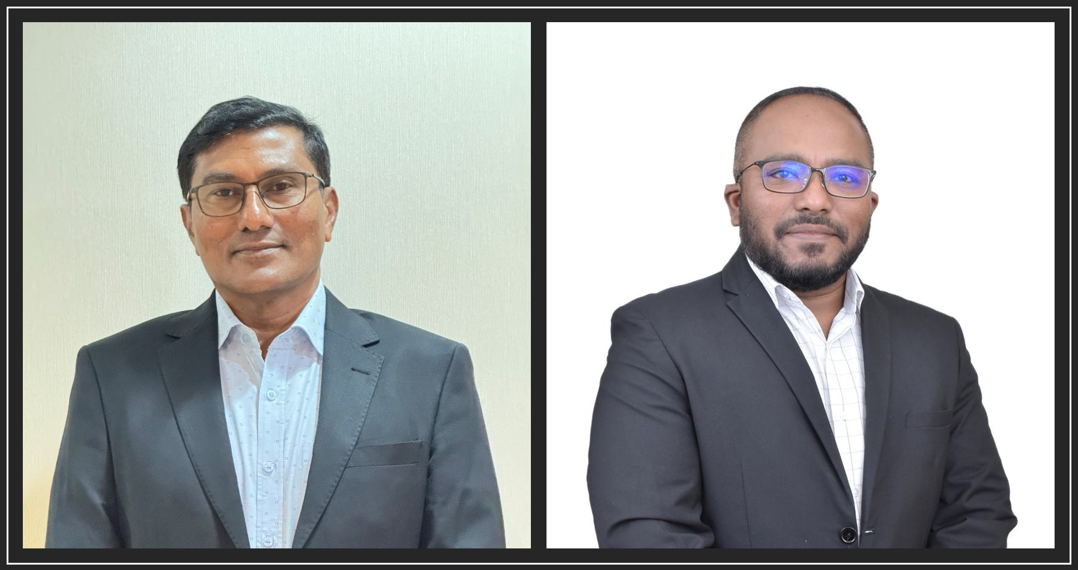
HOW IT STARTED
The idea of registering an Association was born in Indira Gandhi Memorial Hospital (IGMH) in the year 2012 and 2013. At the end of 2013 Maldives Association of Surgeons (MAS) was registered in the Ministry of Home affairs on 14th January 2014, the registration number was T/2014/5/4. The two-founder member were
Dr. Mohamed Shifan
Dr. Abdulla Ubaid

Slide 4
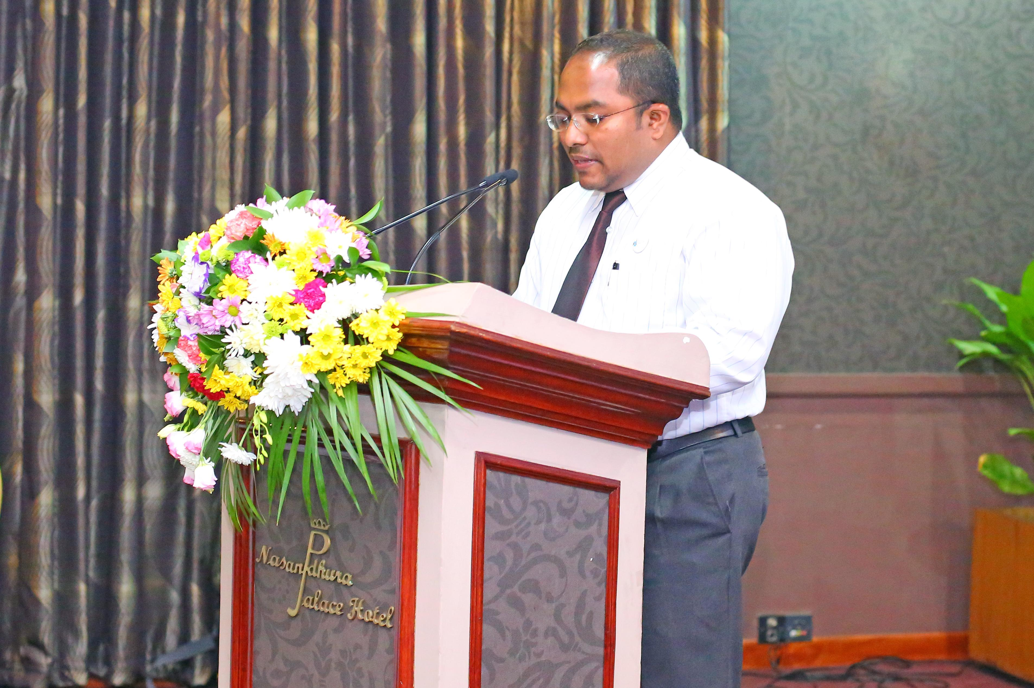
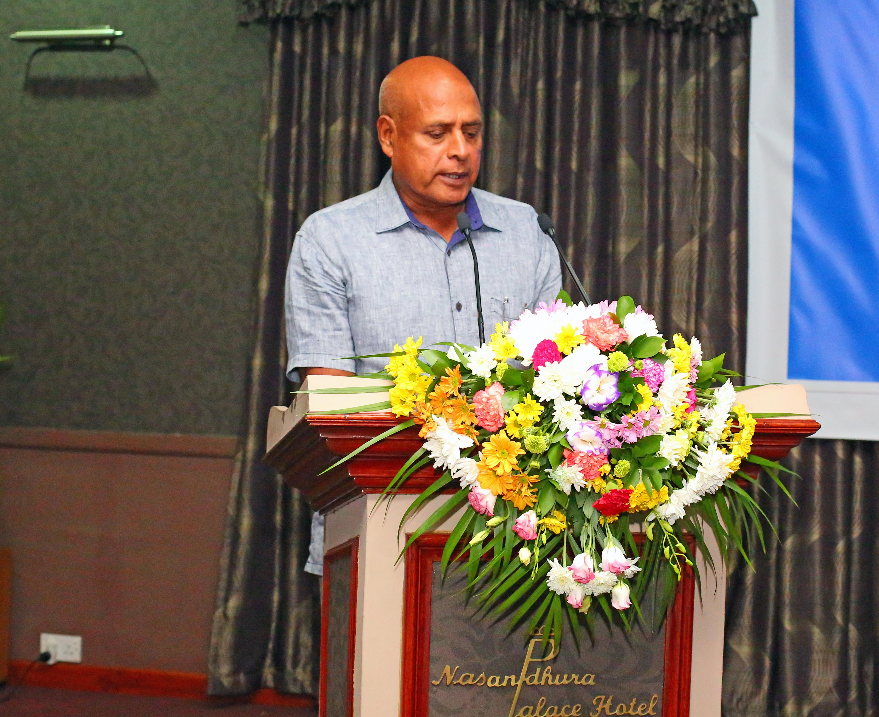
THE INAUGURATION
MAS was Inaugurated with Maldives anesthesiologists Association (MAA) on 16th May 2014.
Our guest of honor was Mr. Ahmed Abdulla who was the minister of health for many years

Slide 5
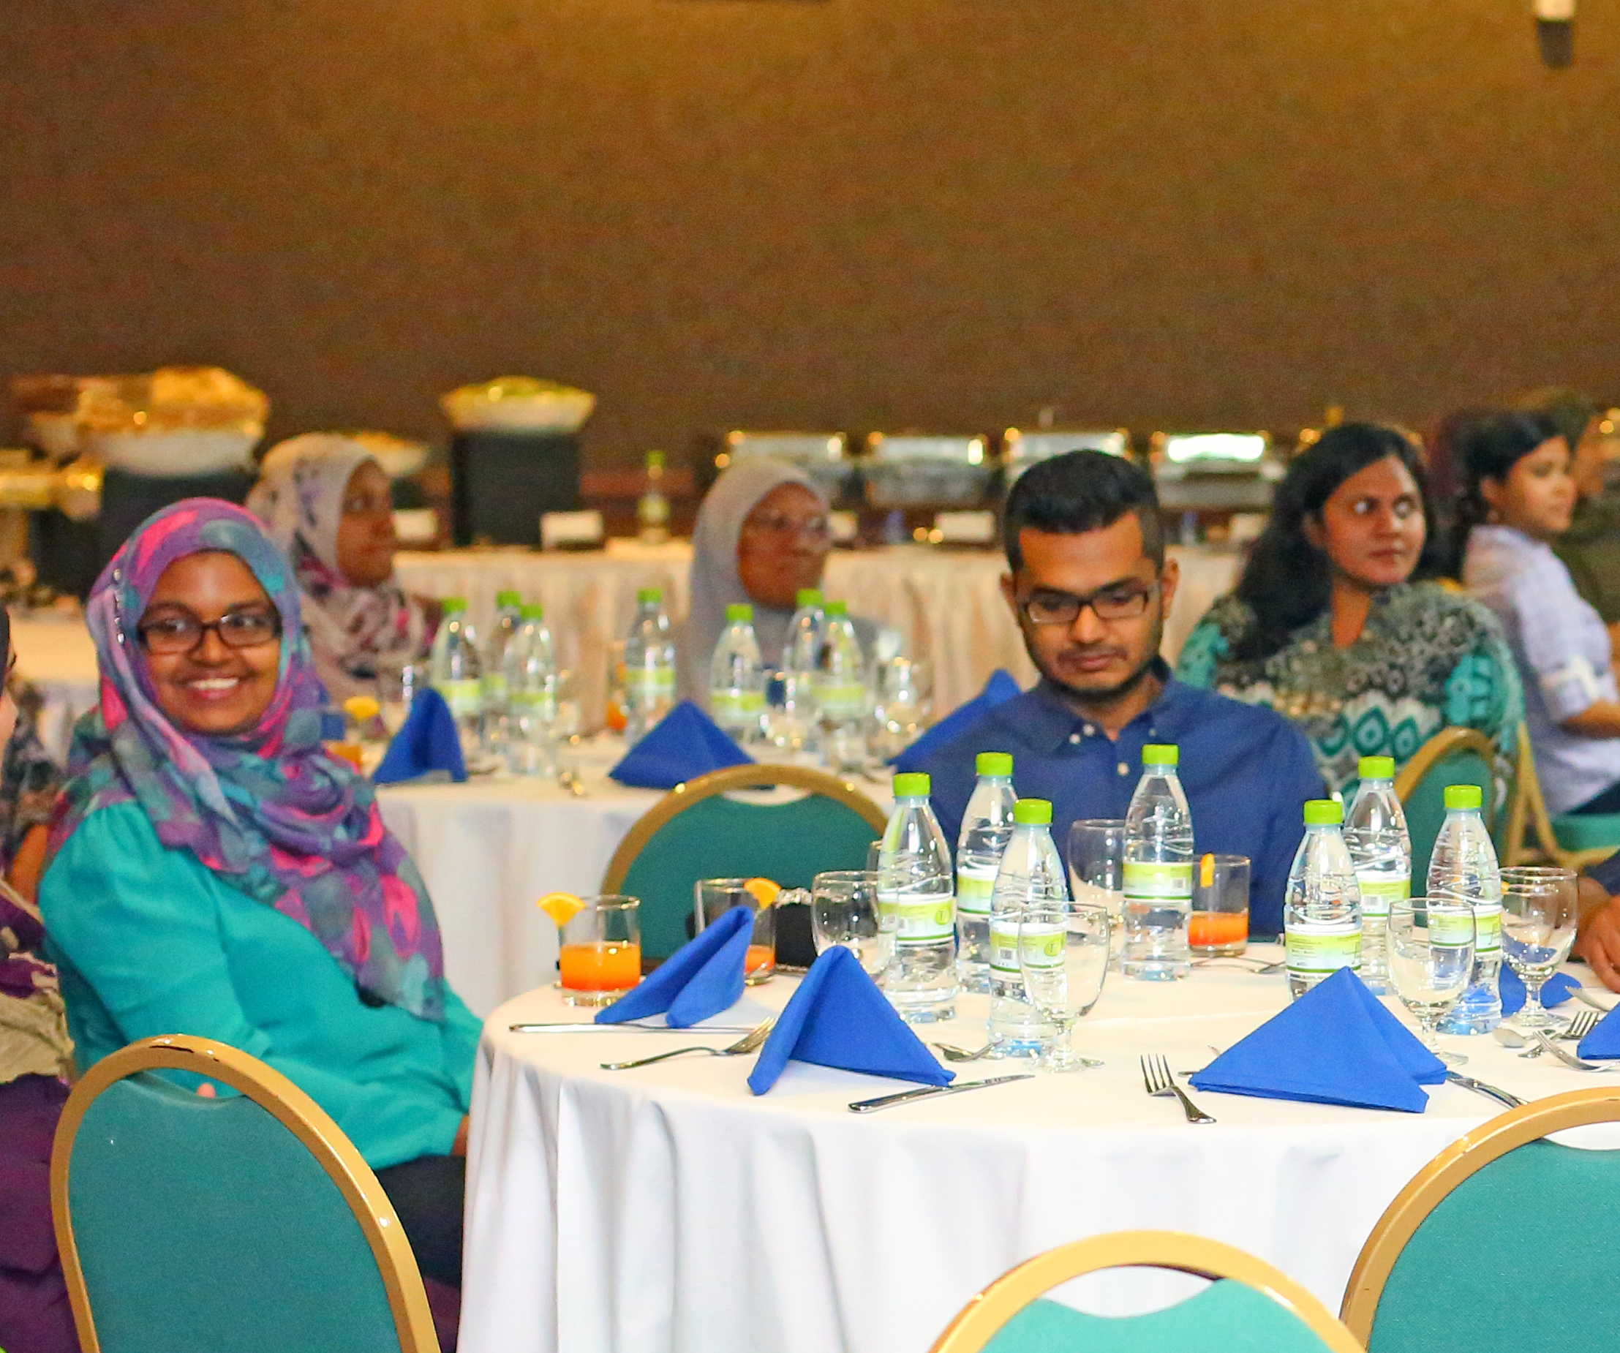
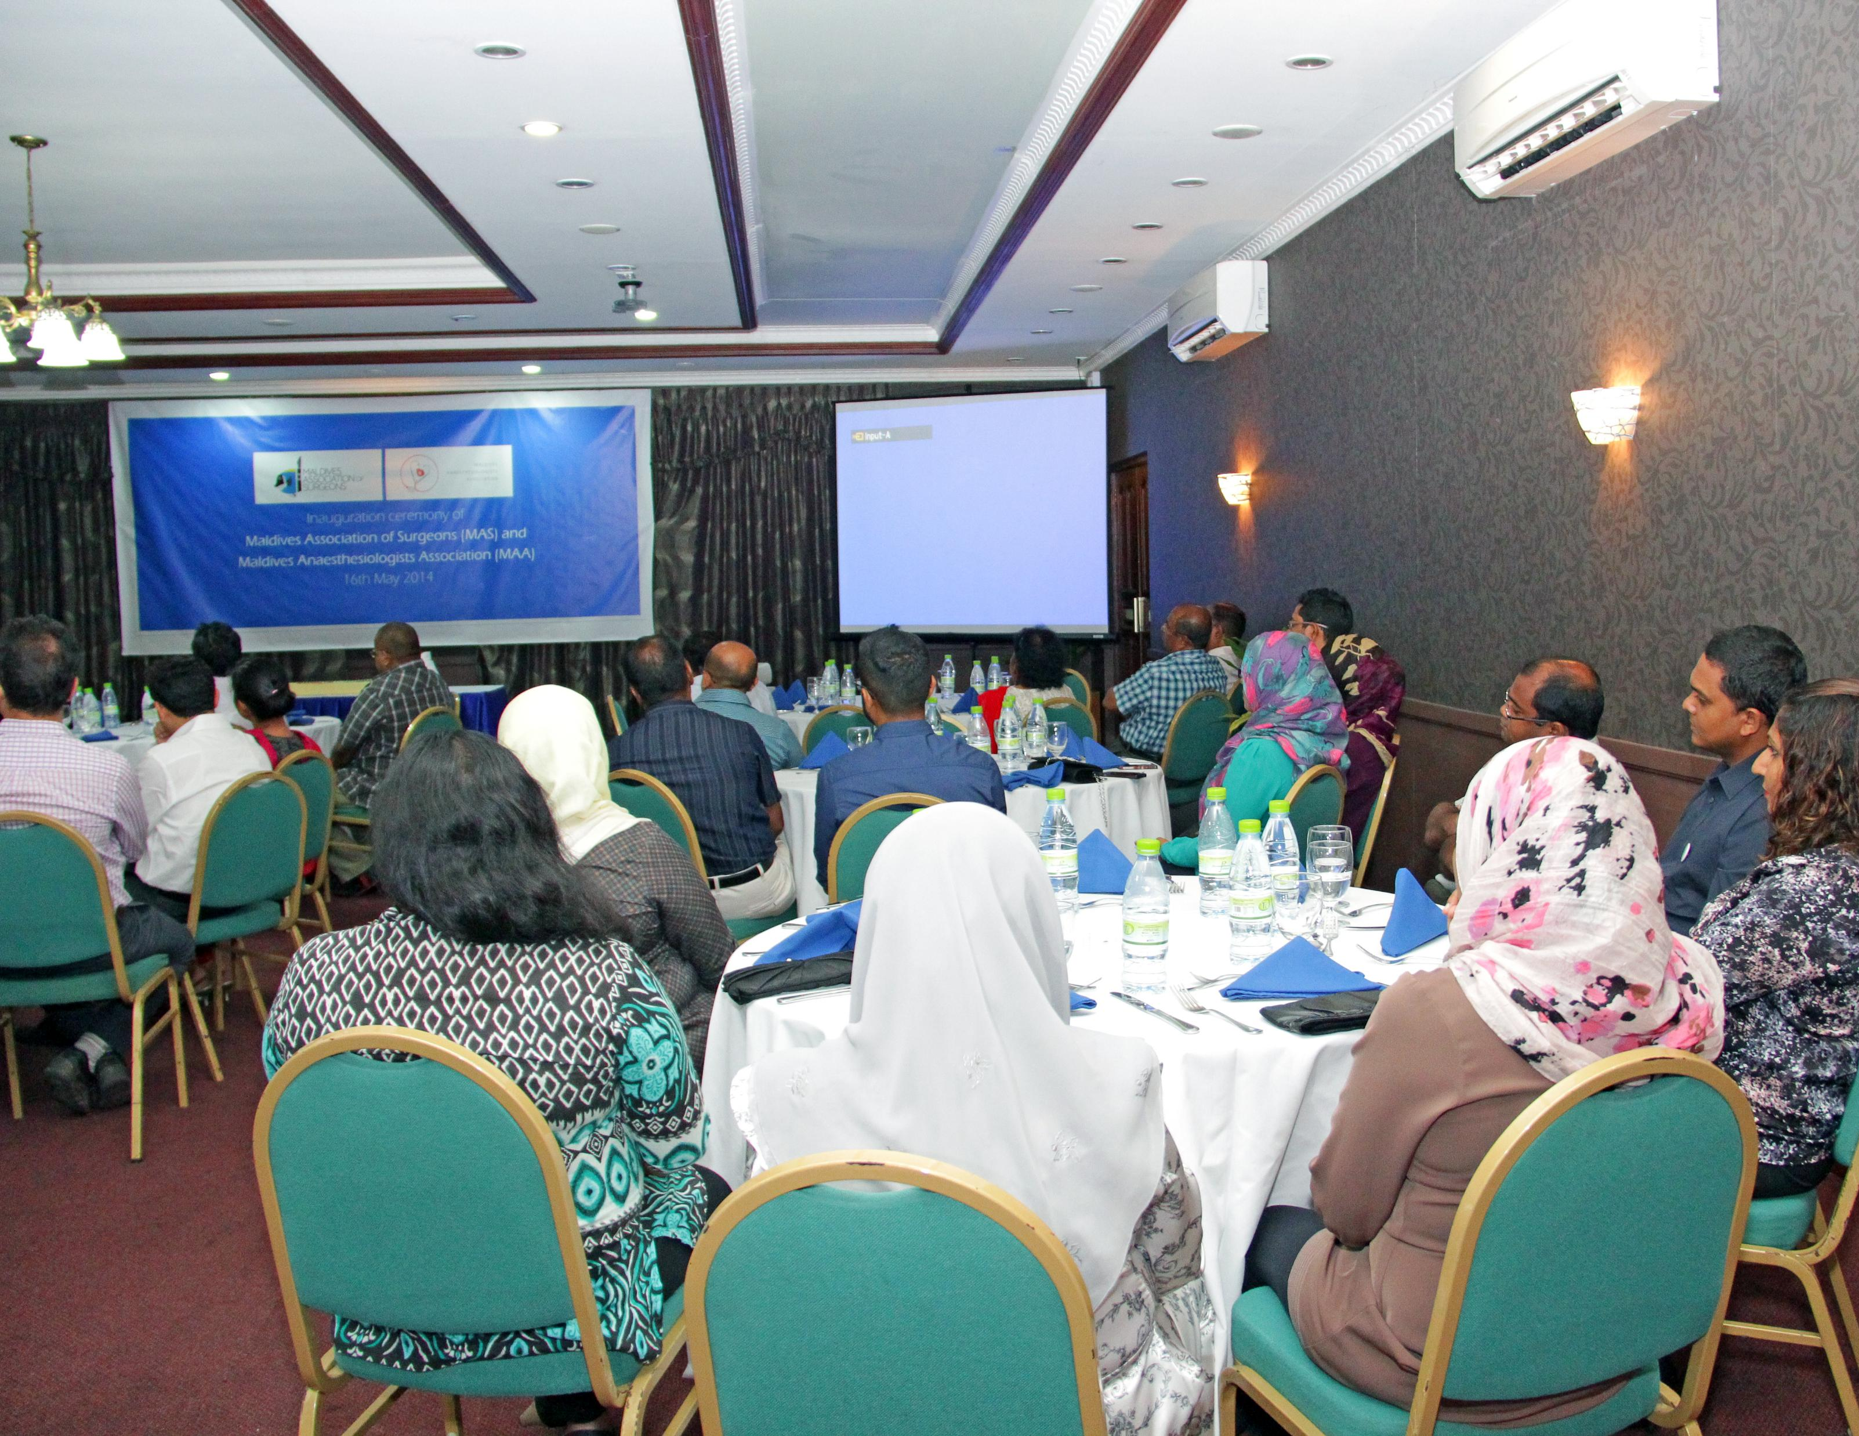
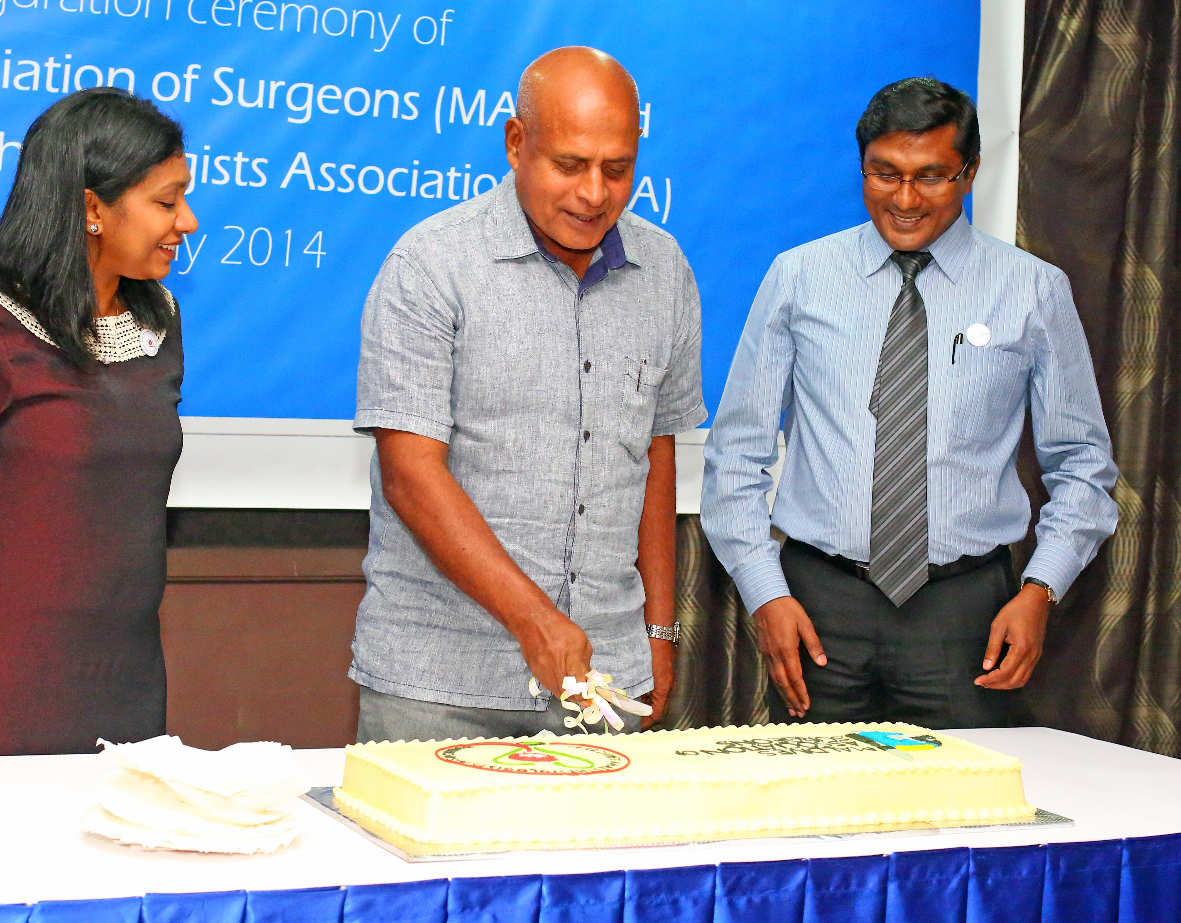
MAS INAUGURATION
The inauguration was attended by dignitaries from medical fraternities representing all disciplines of the medical specialties.

Slide 6
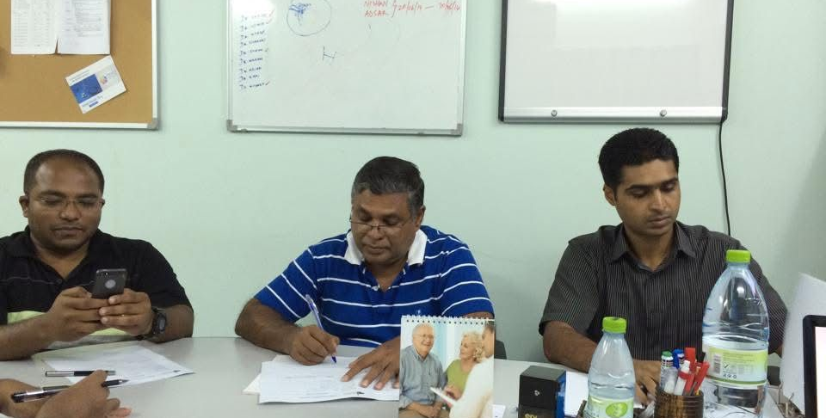
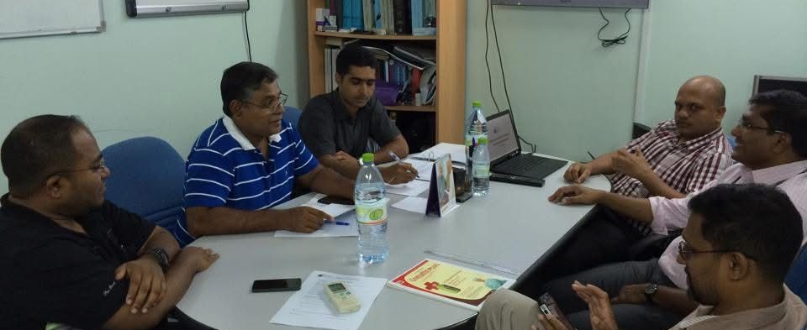
MAS REGULATIONS AND OUR MEMBERS
According to Maldivian legislation about associations and NGOs, MAS should work according to activitiy frame of such organizations, and they should report to Ministry of Home affairs annualy with report about the activities of the association.
Our executive committee is elected from interested members and there are 5 positions in the committee, those are:
President
Vice President
Executive Secretary
Treasurer
Activity Coordinator

Slide 7
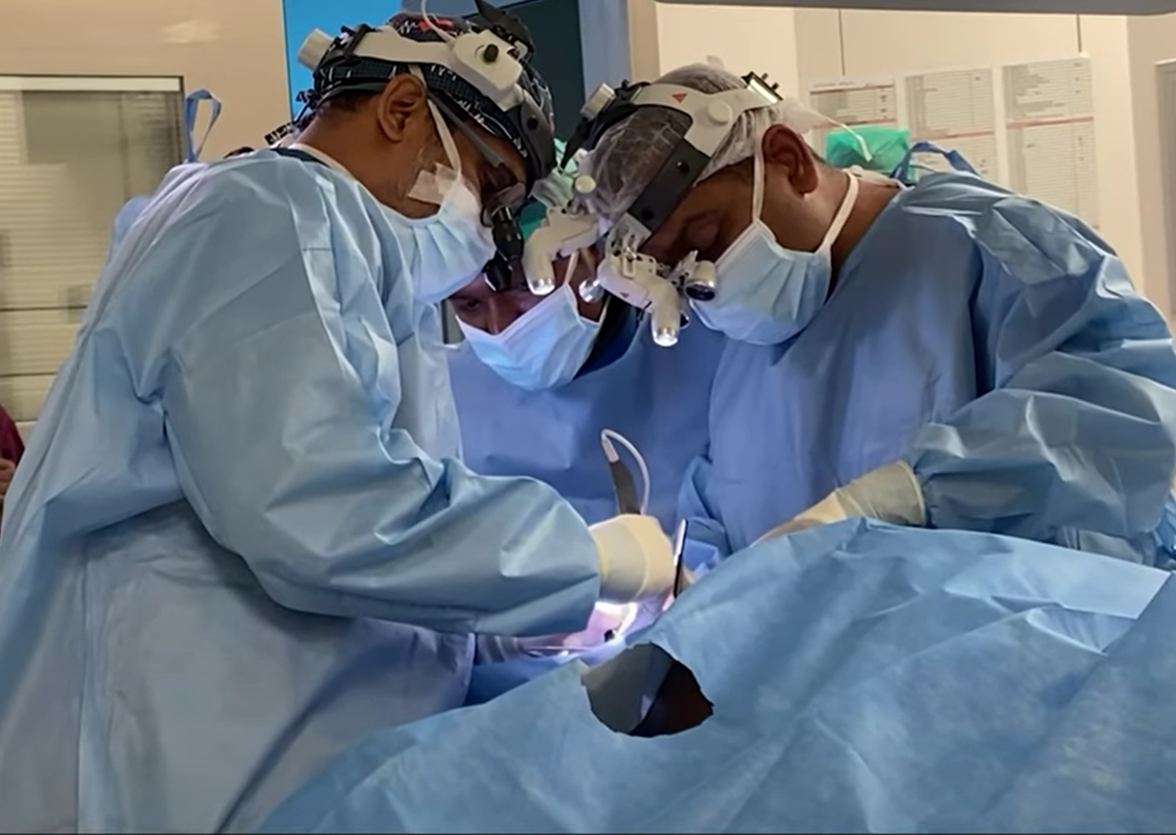
A DECADE OF PROGRESS & DEVELOPMENT
Since its official registration and inauguration in 2014, the Maldives Association of Surgeons (MAS) has played a crucial role in the advancement of surgical care across the country.
Over the past 10 years, MAS members—whether working as part of surgical teams in various hospitals or as individual professionals—have contributed significantly by undergoing subspecialty training and initiating key developmental programs in their respective fields.
Photo by ADK Hospital: CTVS

Slide 8
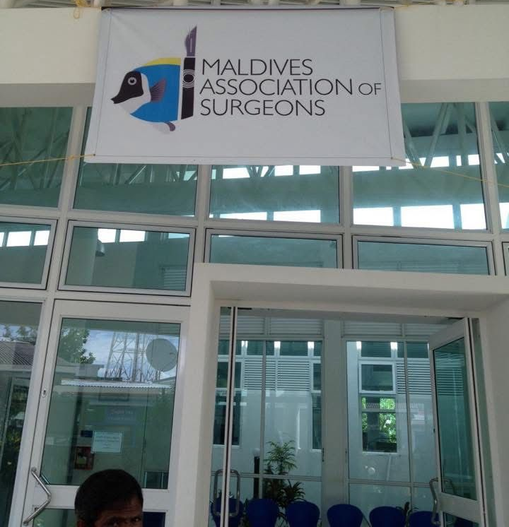
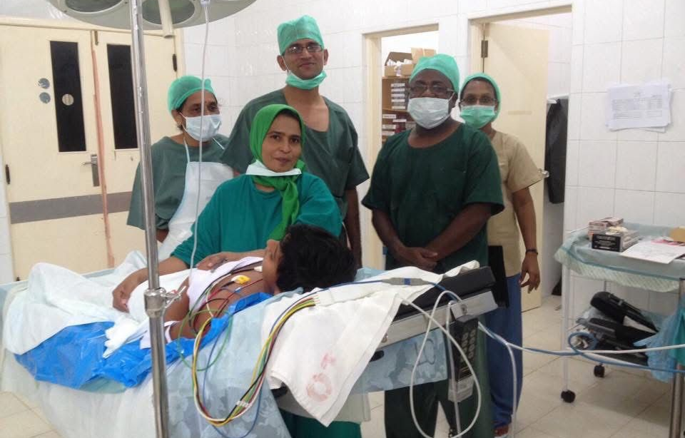
Key Activities of the MAS & Members
1. Voluntary Surgical Camps and Health Awareness Programs
a. Circumcision Camp – November 2014
  In November 2014, MAS organized a voluntary circumcision camp in Lh. Atoll in collaboration with local healthcare providers. The camp provided much-needed surgical services, during which numerous circumcision procedures were successfully performed. This initiative played a vital role in supporting local communities and enhancing surgical outreach

Slide 9
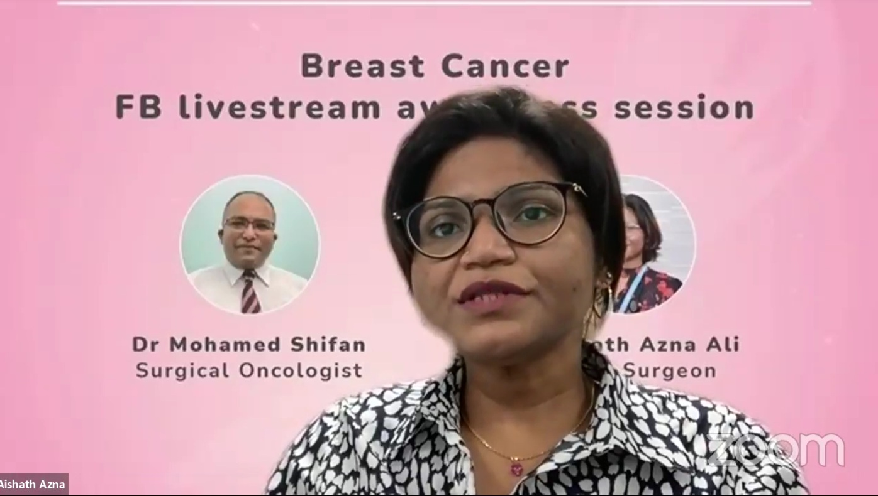
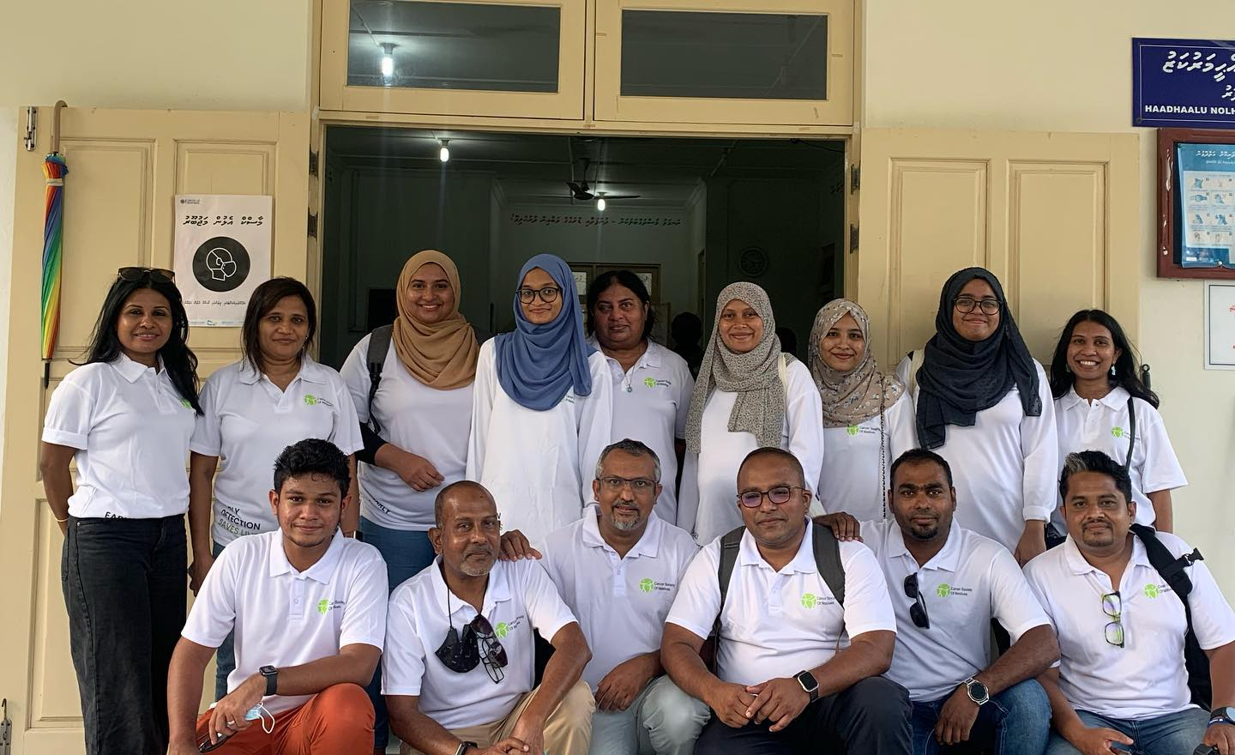
Key Activities of the MAS & Members
1. Voluntary Surgical Camps and Health Awareness Programs
b. Health Awareness Programs
Our members have consistently participated in various health awareness initiatives in partnership with other organizations. These include:
Cancer Screening Programs: Promoting early detection and prevention of various cancers.
Tobacco Cessation Campaigns: Educating the public on the risks of tobacco use and providing support for quitting.
First Aid and ATLS Training Programs: Ensuring healthcare providers and community members are well-prepared to handle emergencies and trauma cases.
Advanced Wound Care Training: Enhancing knowledge and skills in wound management, improving patient outcomes in both urban and remote areas.

Slide 10
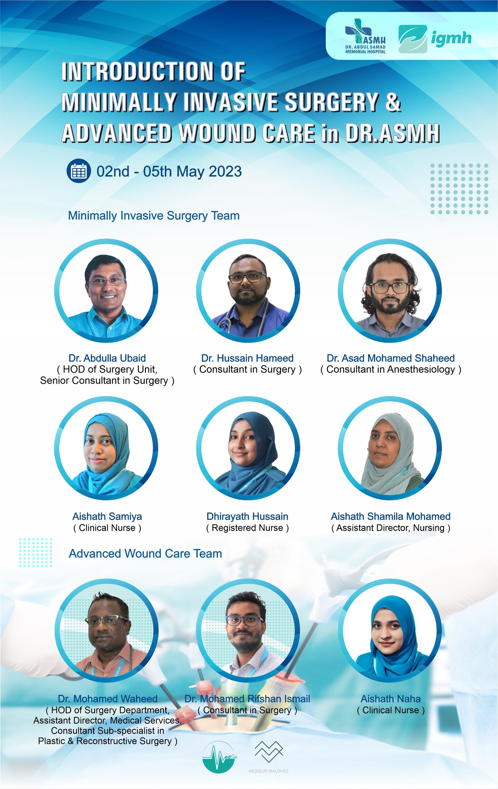
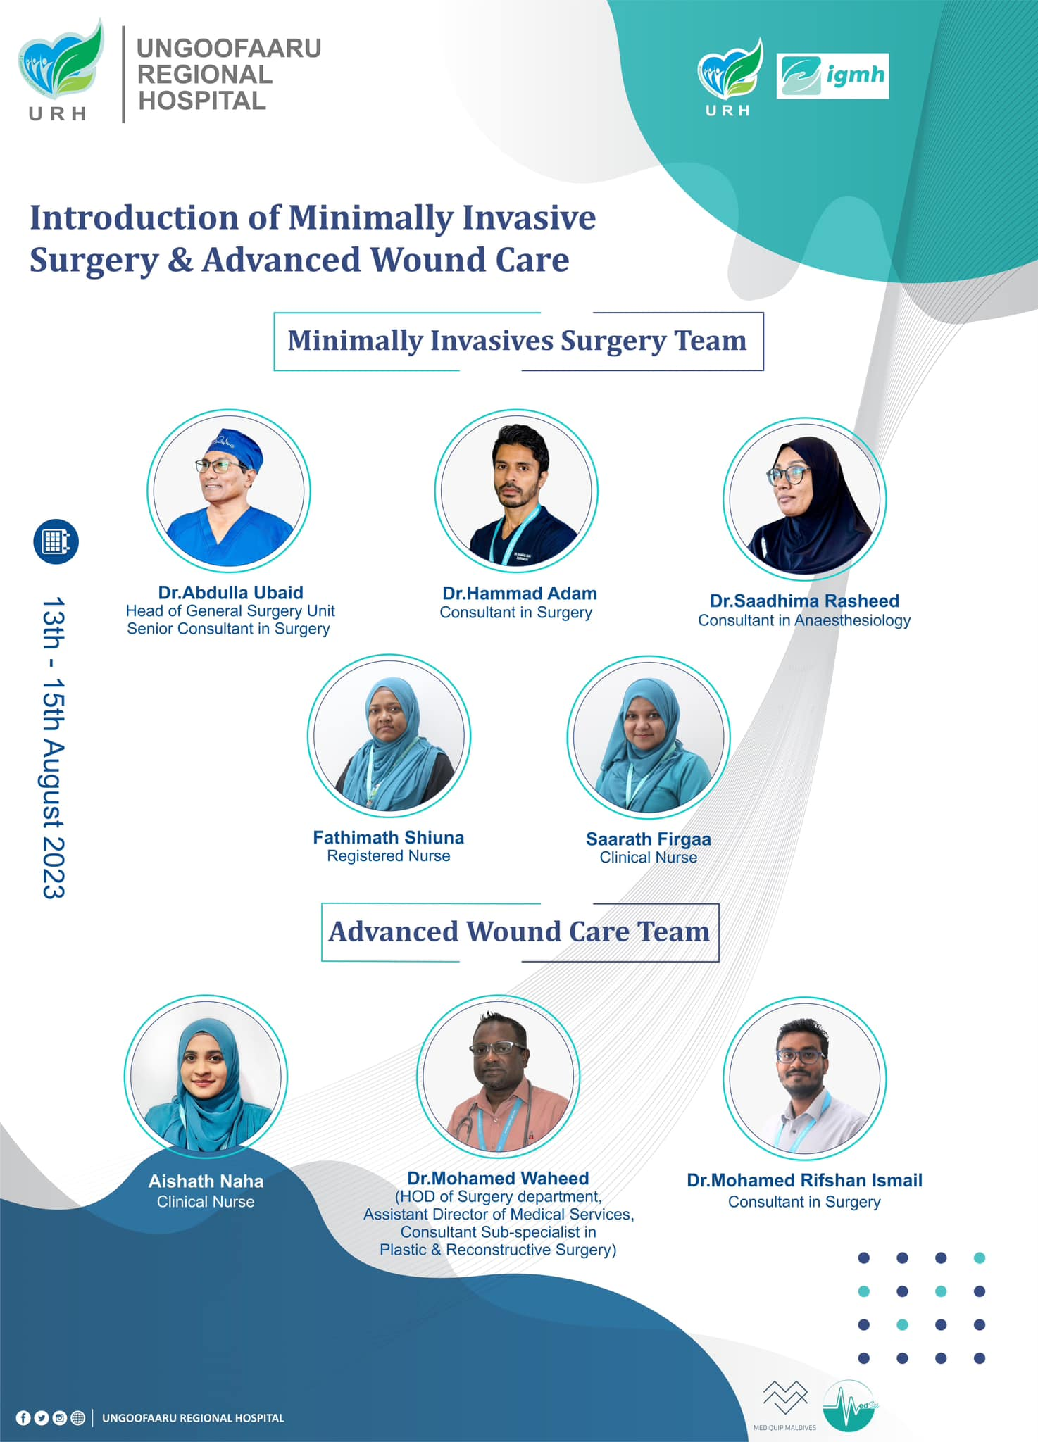
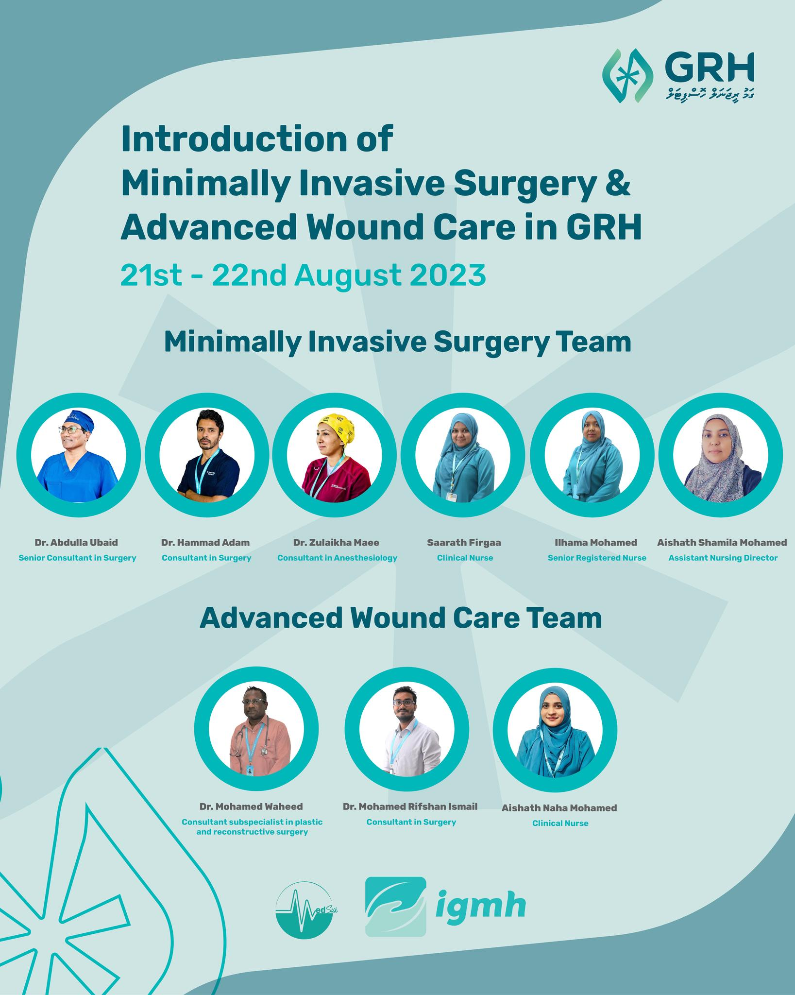
Key Activities of the MAS & Members
2. Contribution to the Development of Surgical Services in Regional Hospitals
MAS members have played a vital role in the expansion and development of surgical services in regional hospitals, particularly in the introduction of advanced surgical techniques such as Minimally Invasive Surgeries (MIS) and Advanced Wound Care.

Slide 11
Key Activities of the MAS & Members
2. Contribution to the Development of Surgical Services in Regional Hospitals
Expansion of Minimally Invasive Surgeries (MIS) and Advanced Wound Care
In 2022 and 2023, surgery teams from the Department of Surgery at IGMH and Dharumavantha Hospital (DH), led by MAS members, introduced minimally invasive surgical techniques in four regional hospitals, including:
Kulhudhuffushi Regional Hospital
Abdul Samad Memorial Hospital, GDh. Thinadhoo
UngooFaaru Regional Hospital
L. Gan Regional Hospital

Slide 12
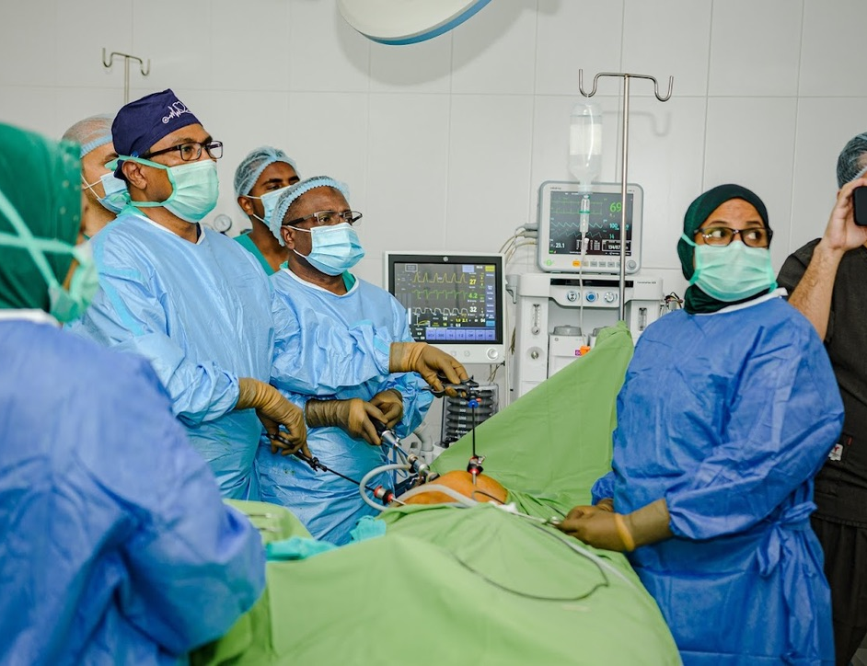
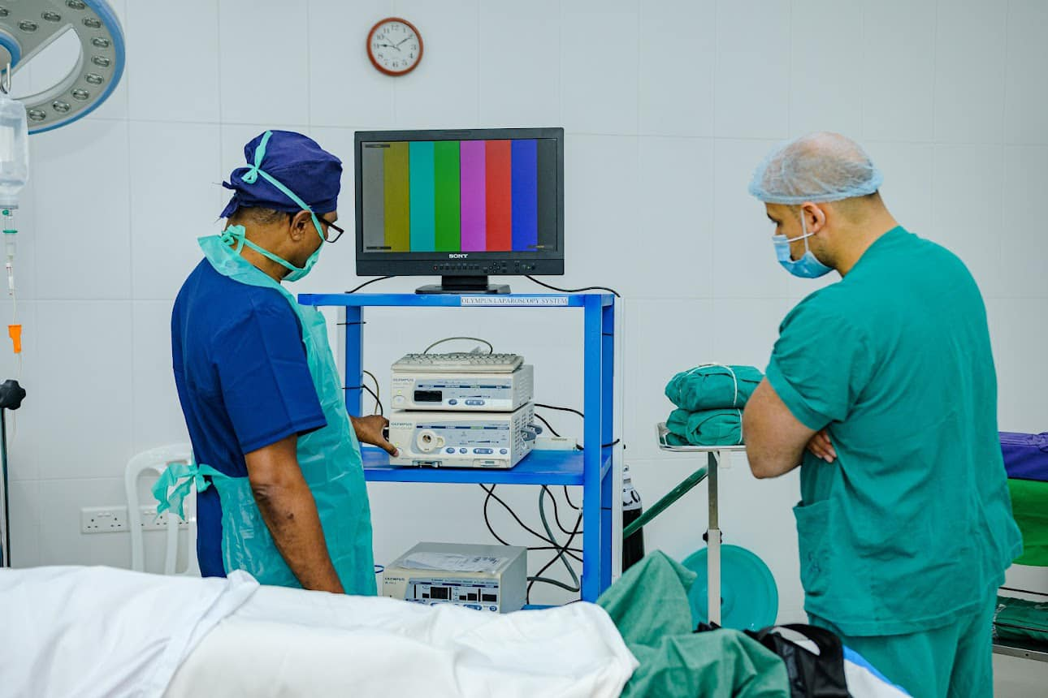
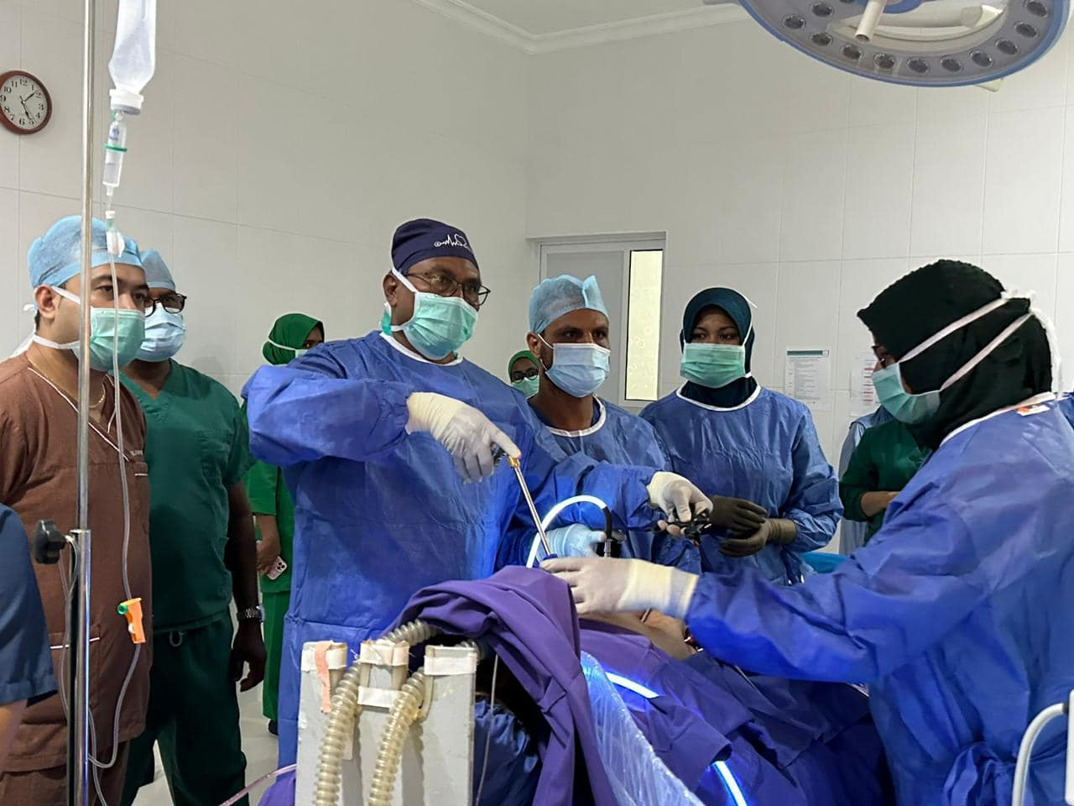
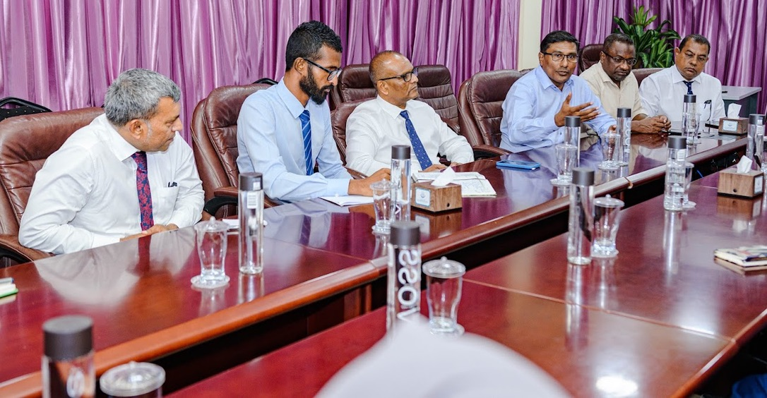
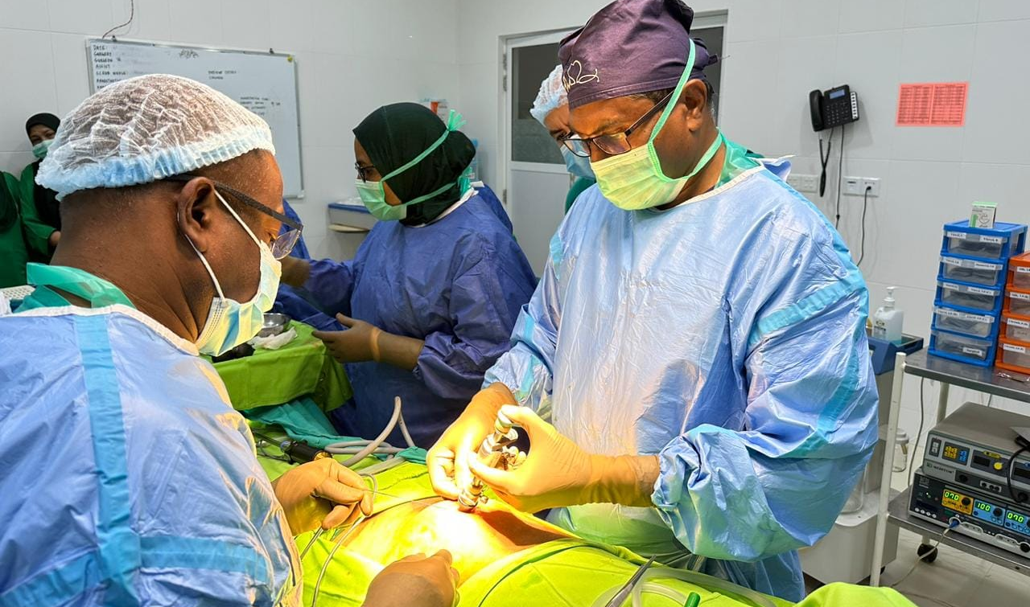
KRH

Slide 13
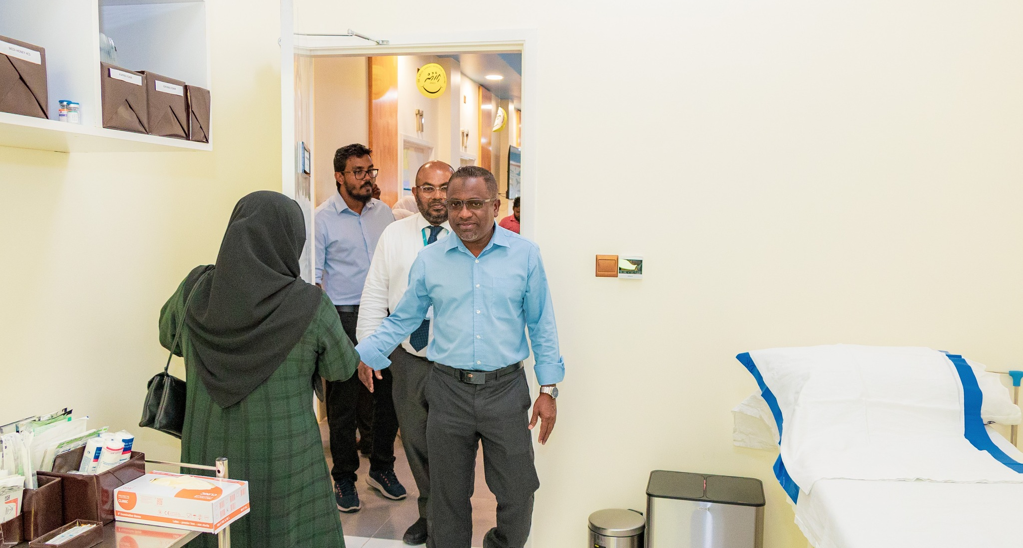
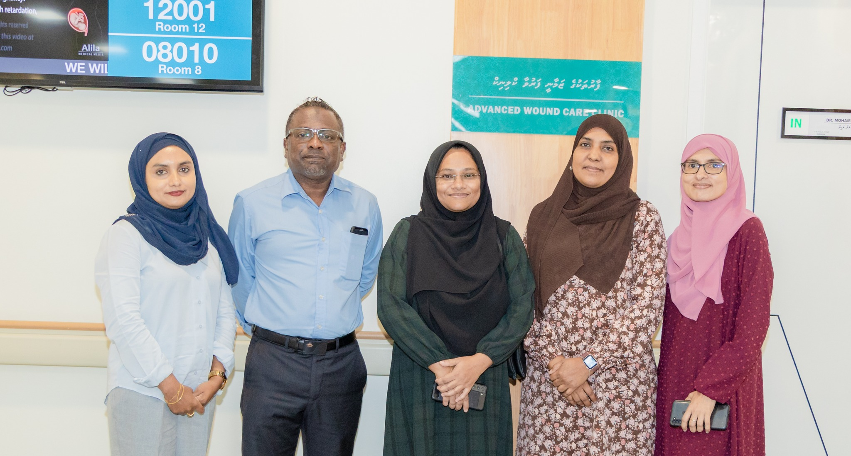
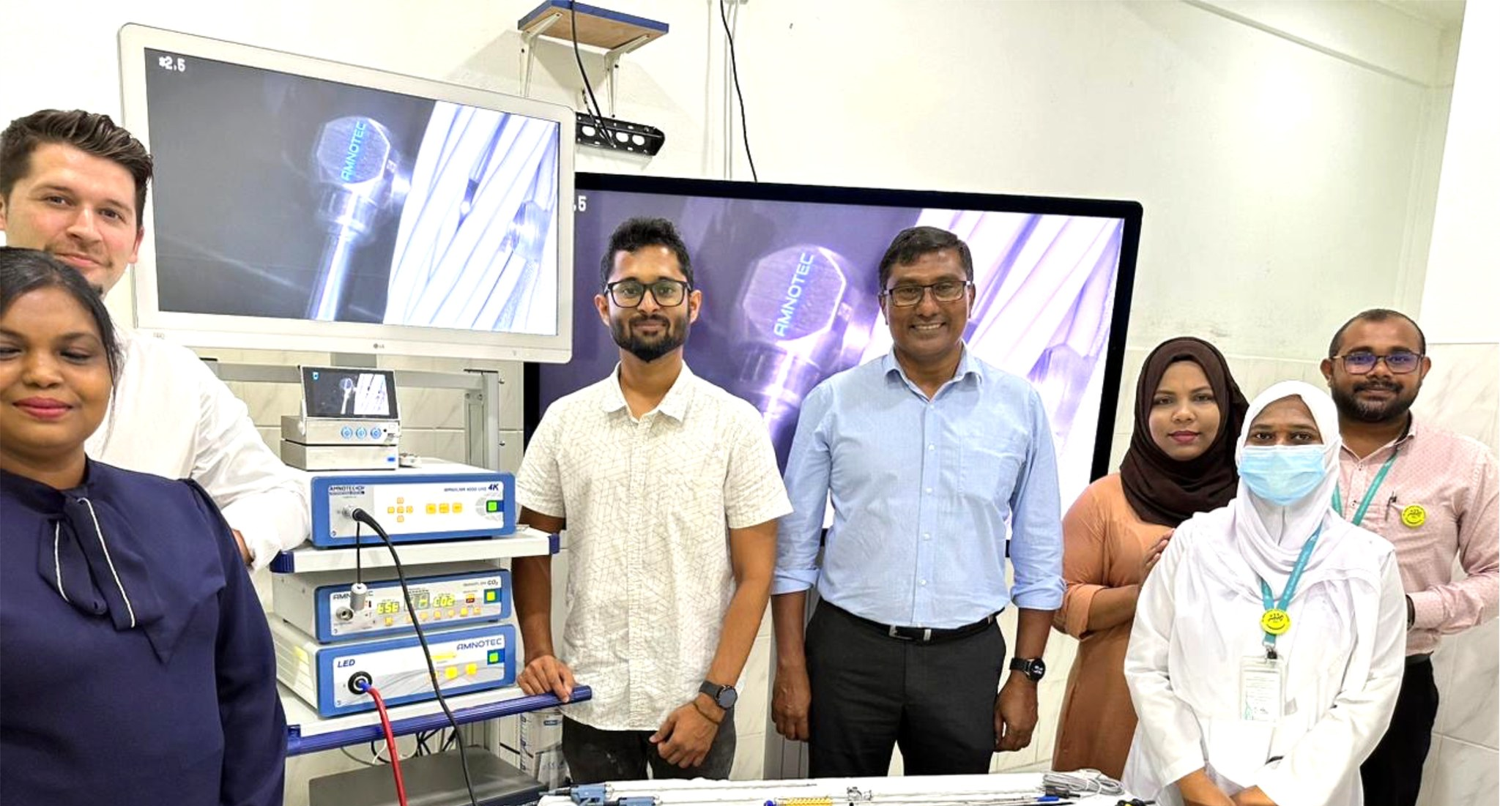
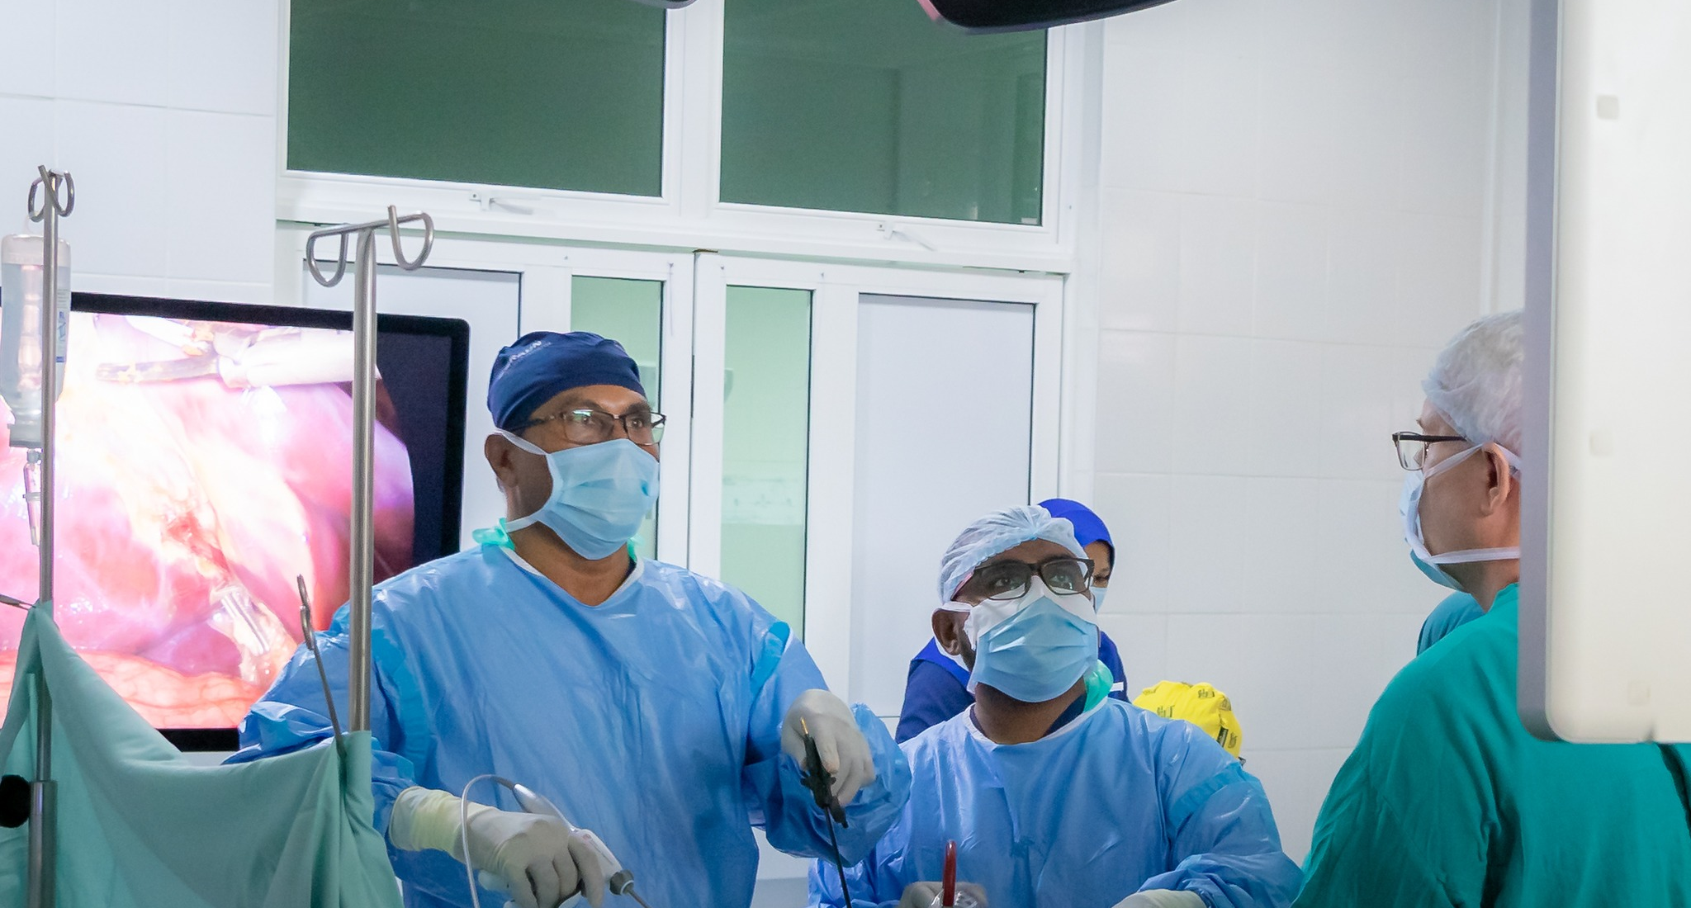
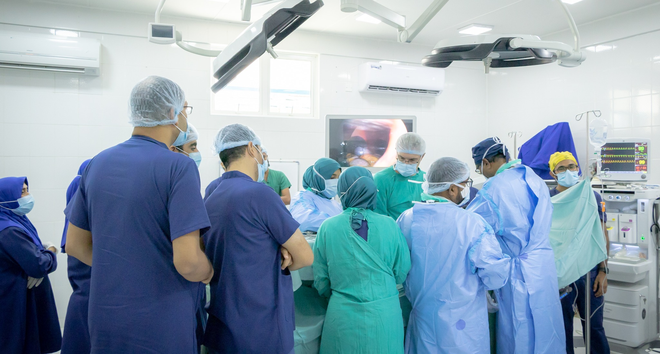
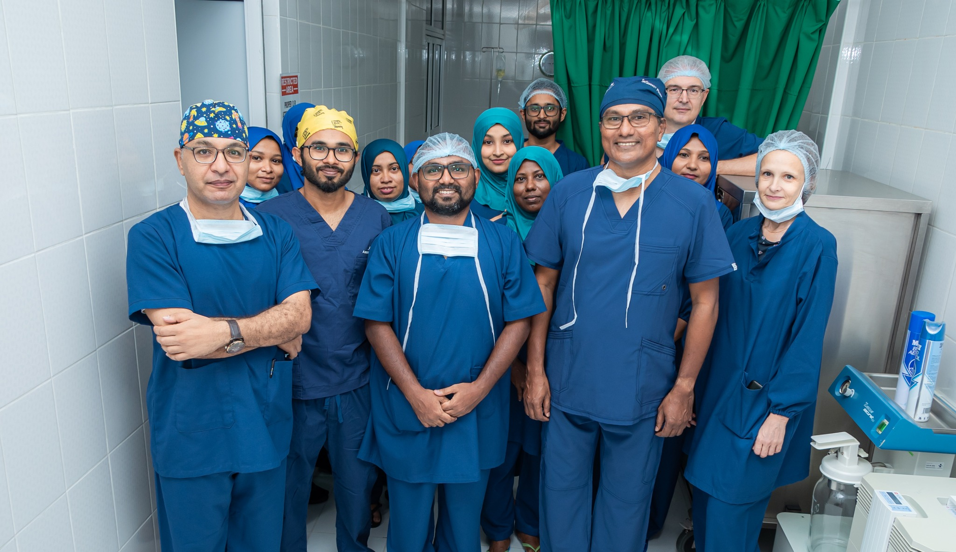
ASMH

Slide 14
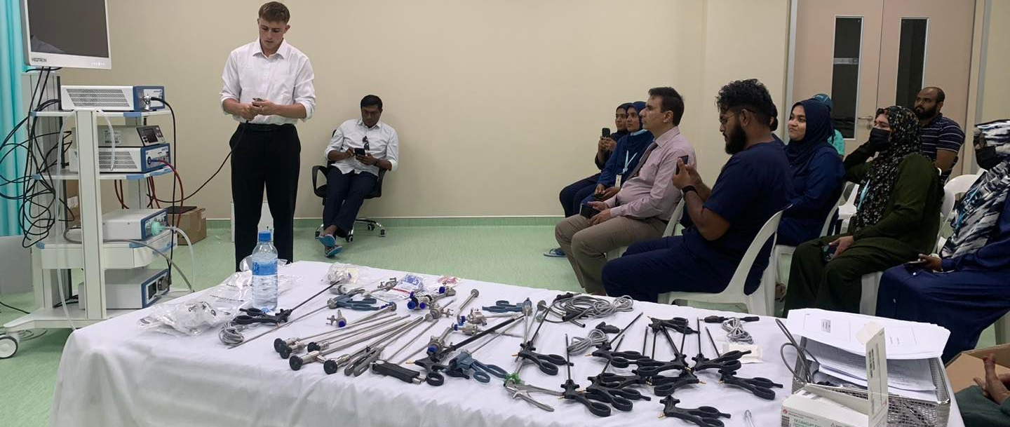
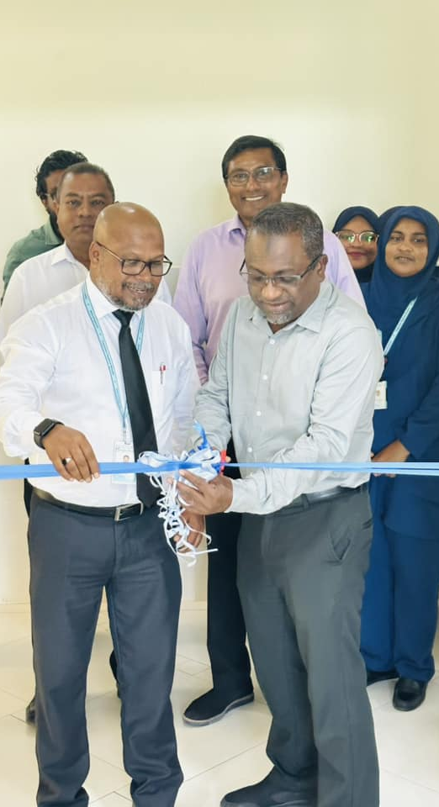
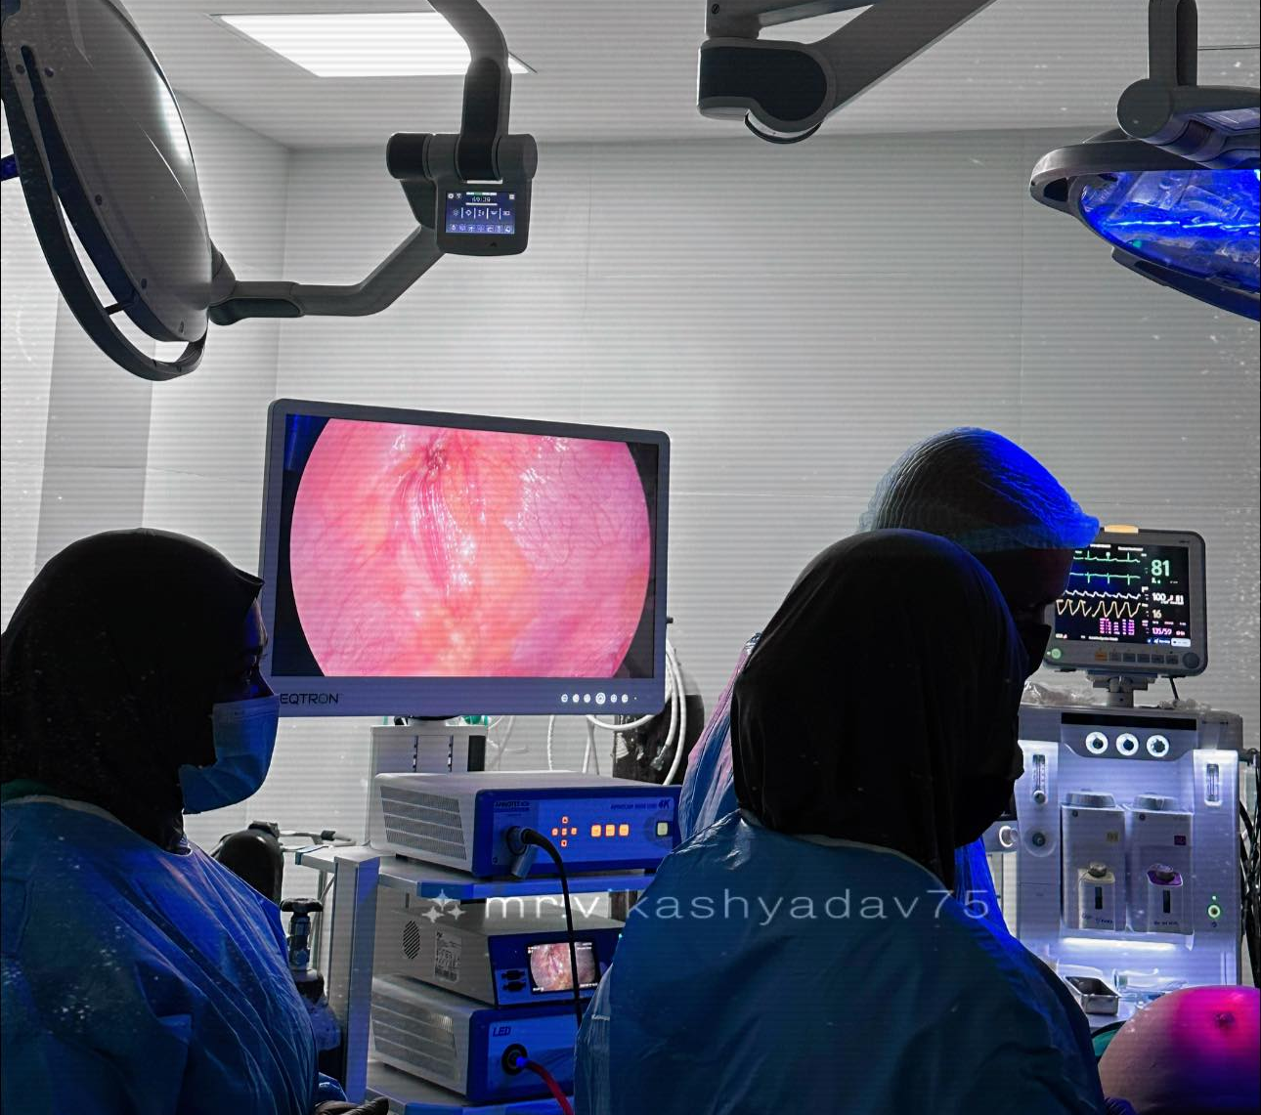
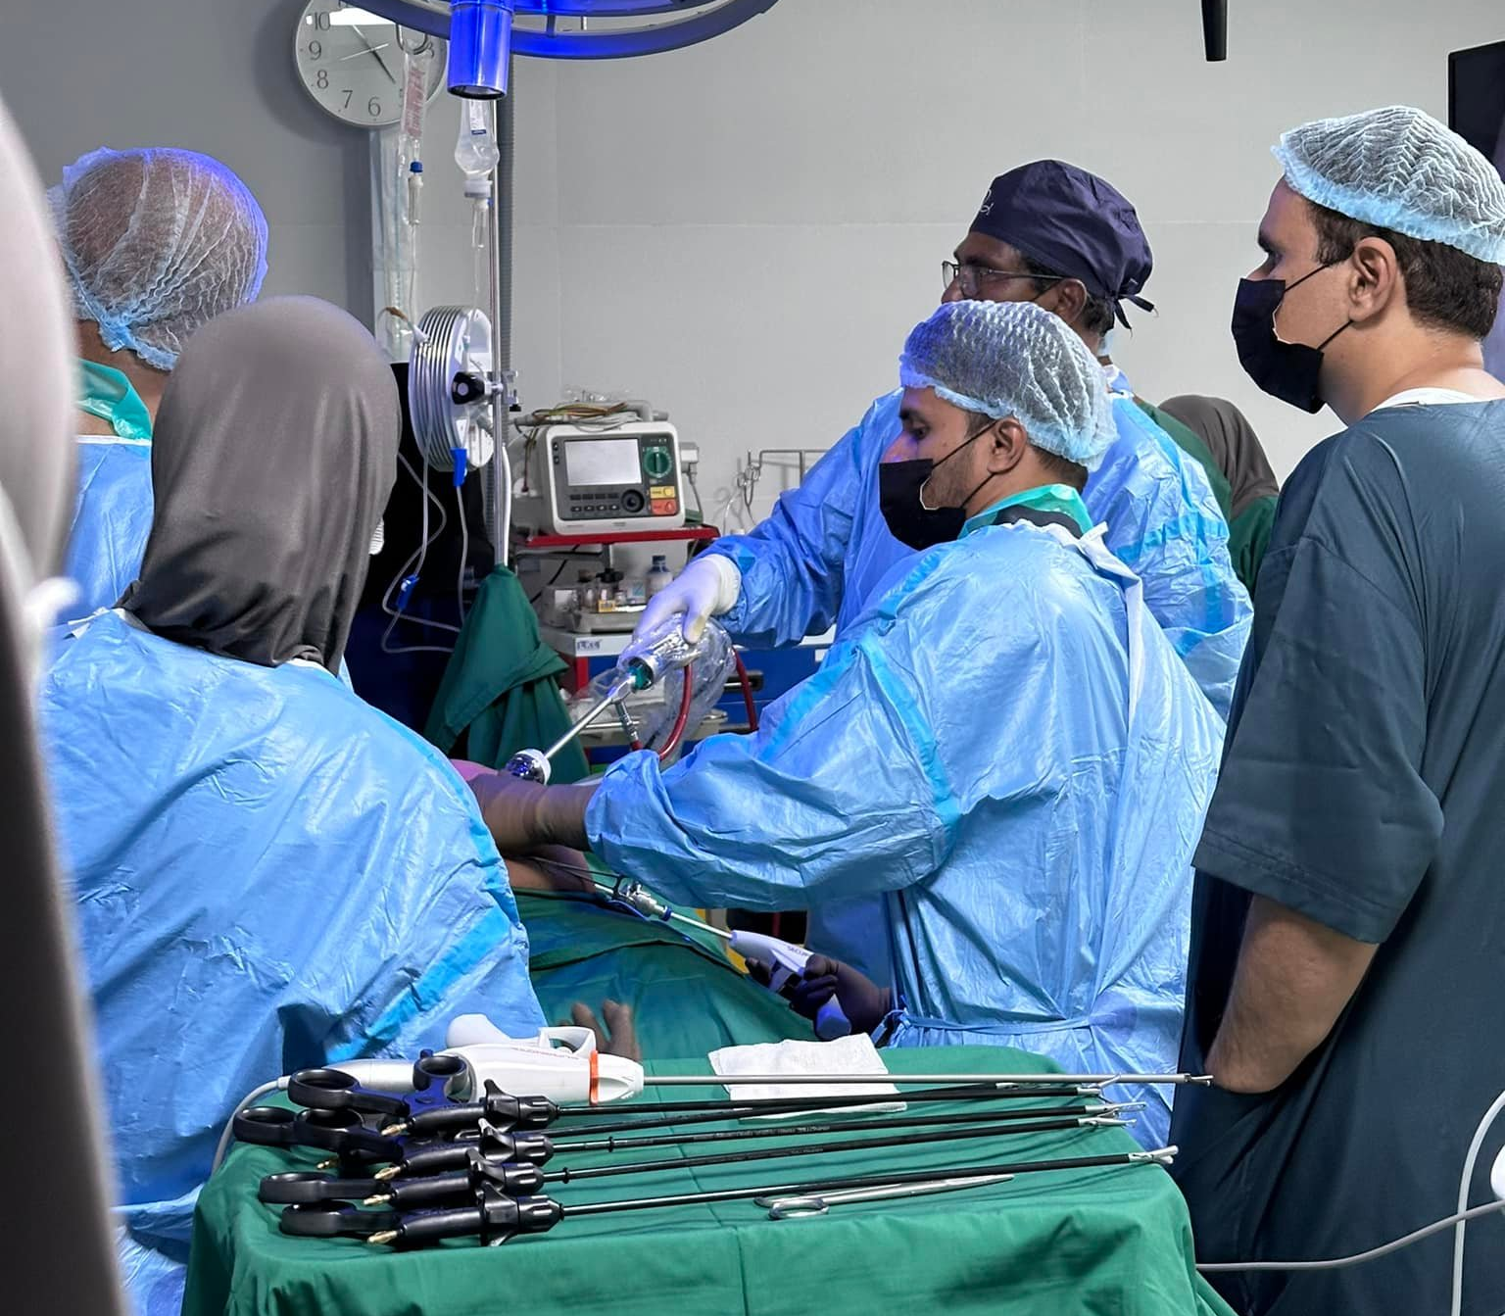
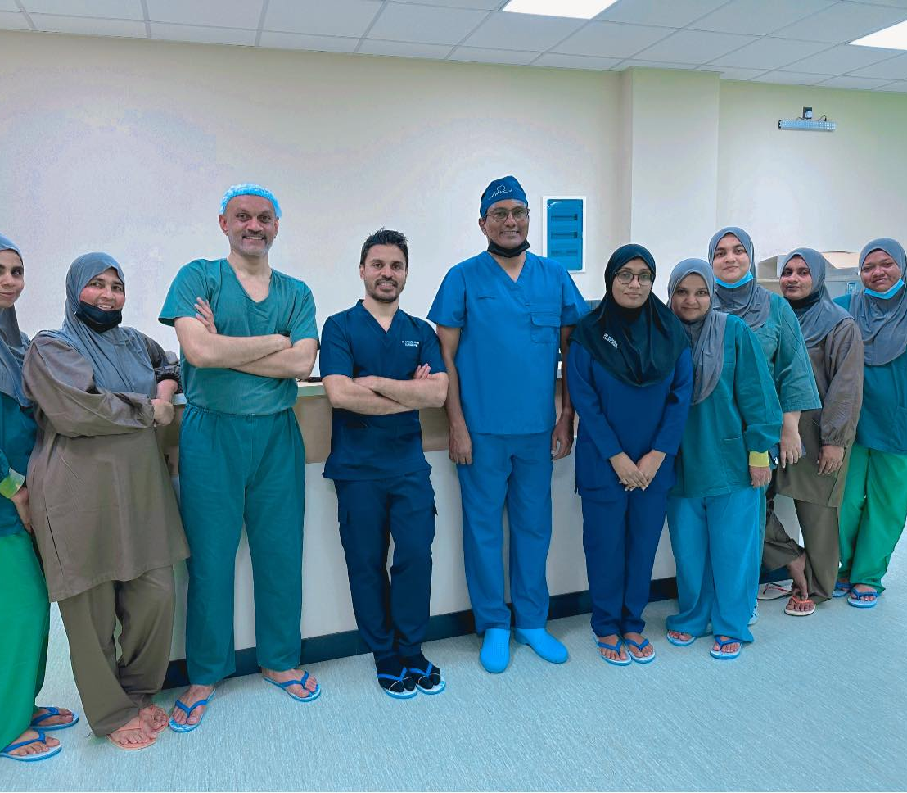
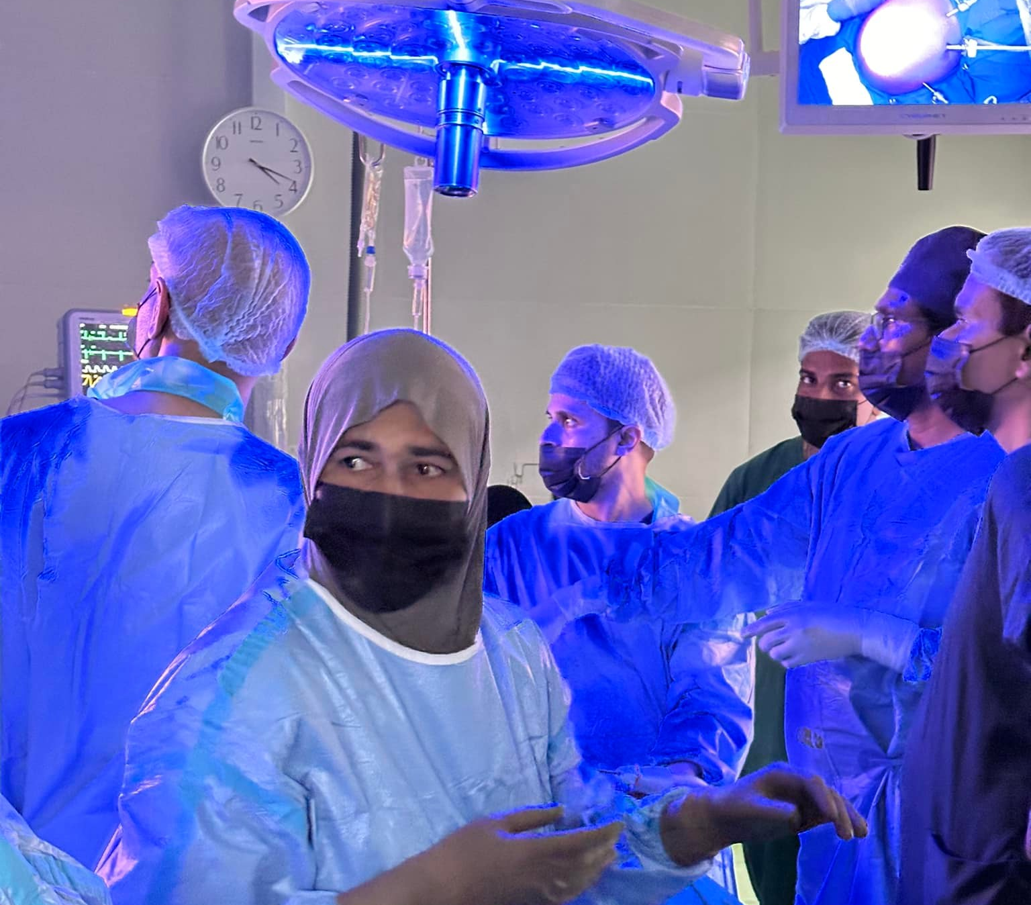
URH

Slide 15
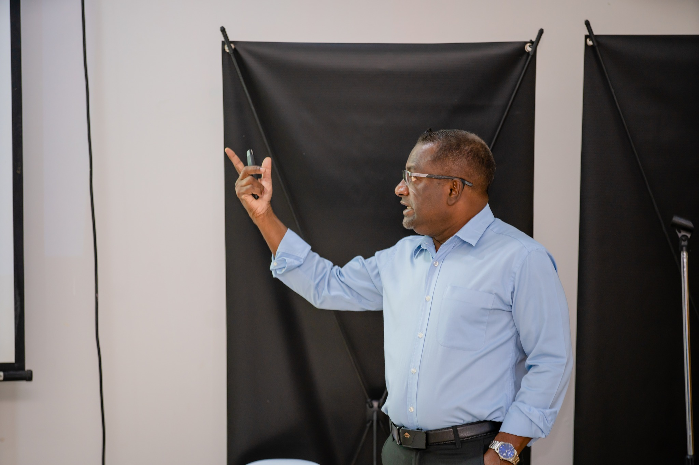
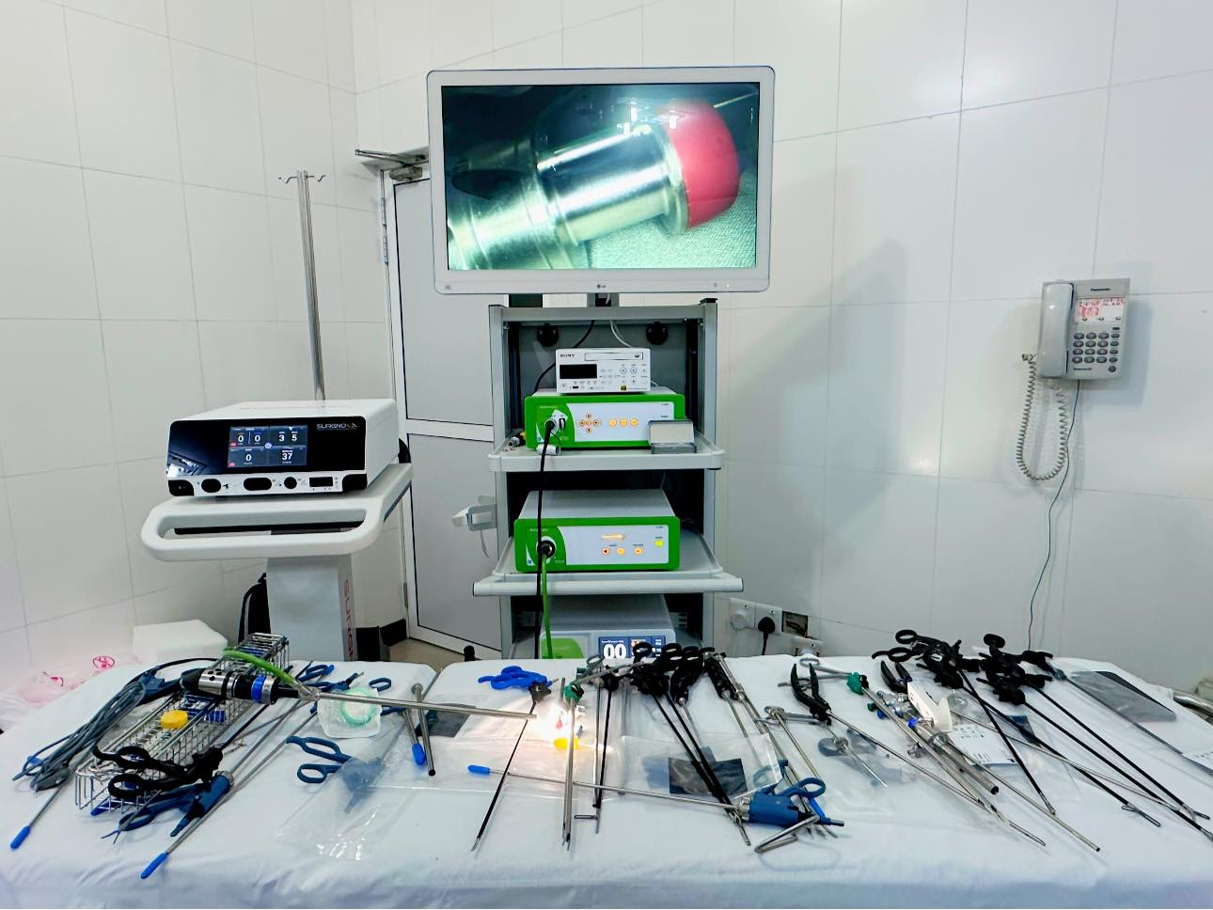
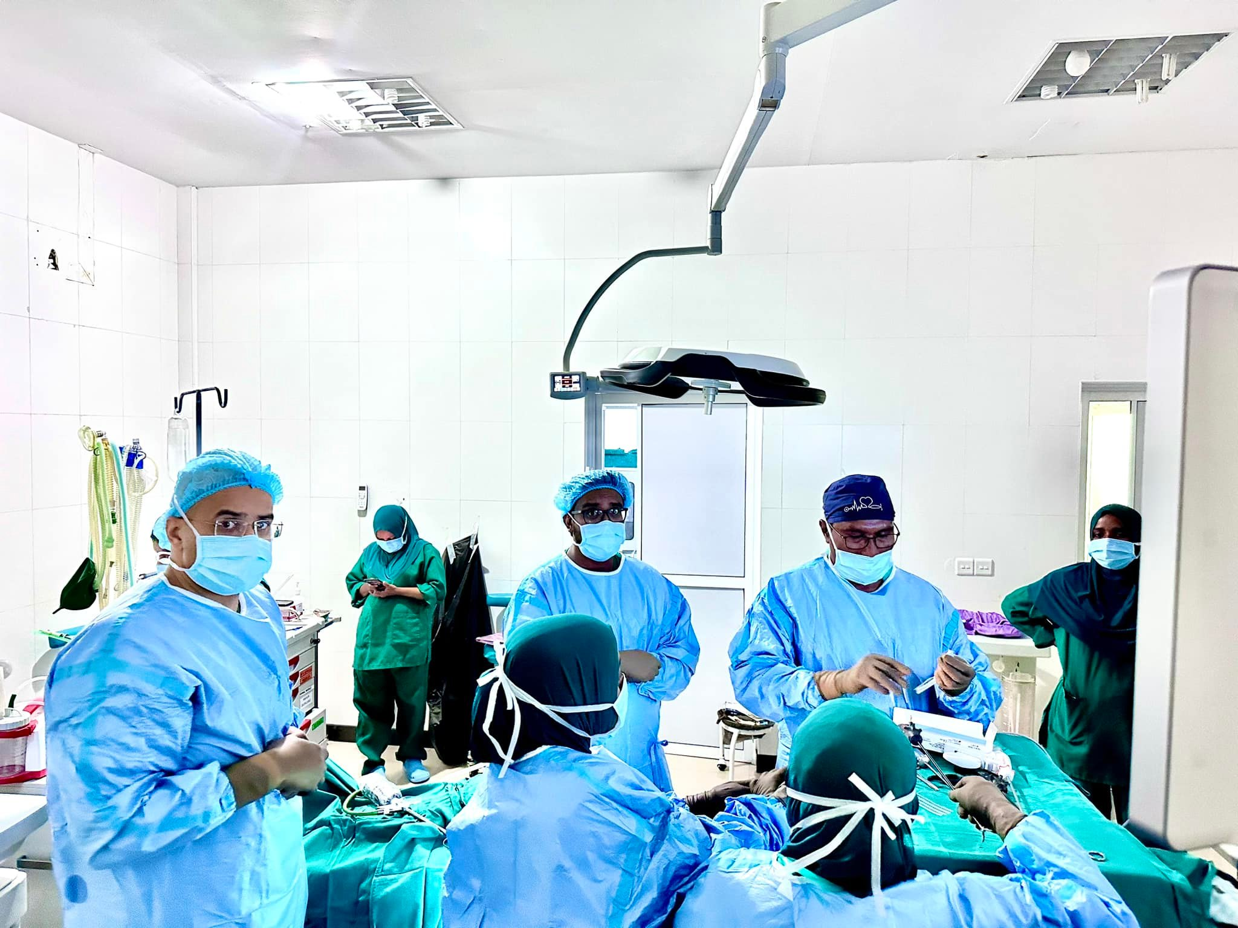
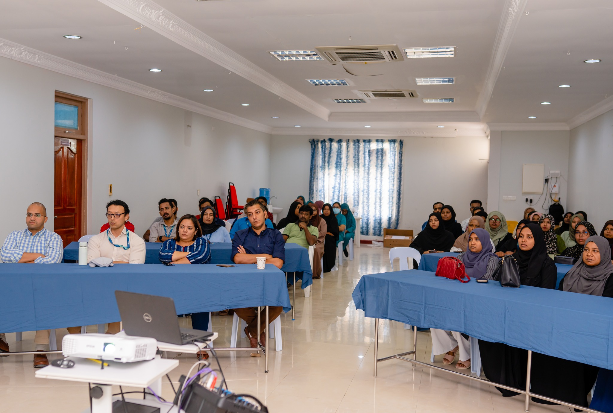
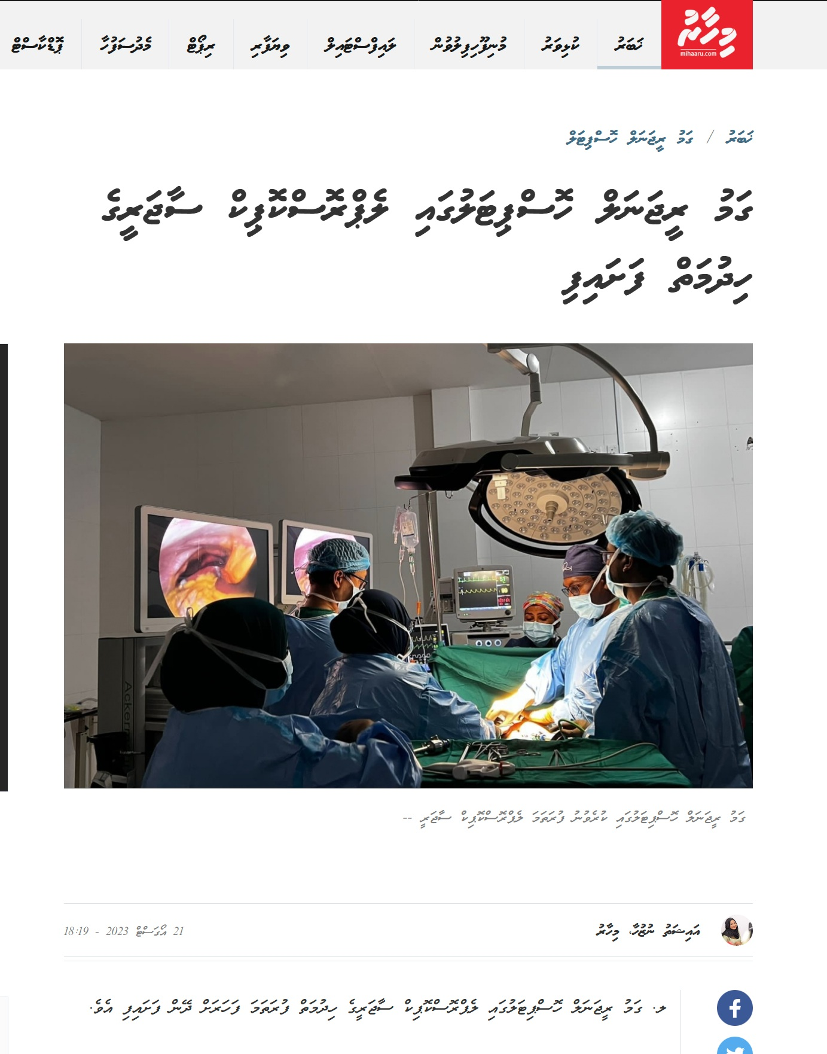
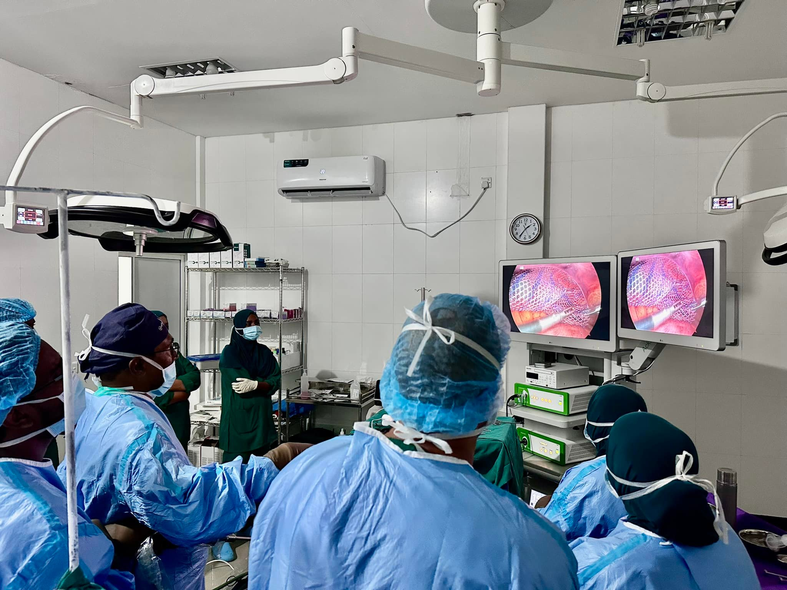
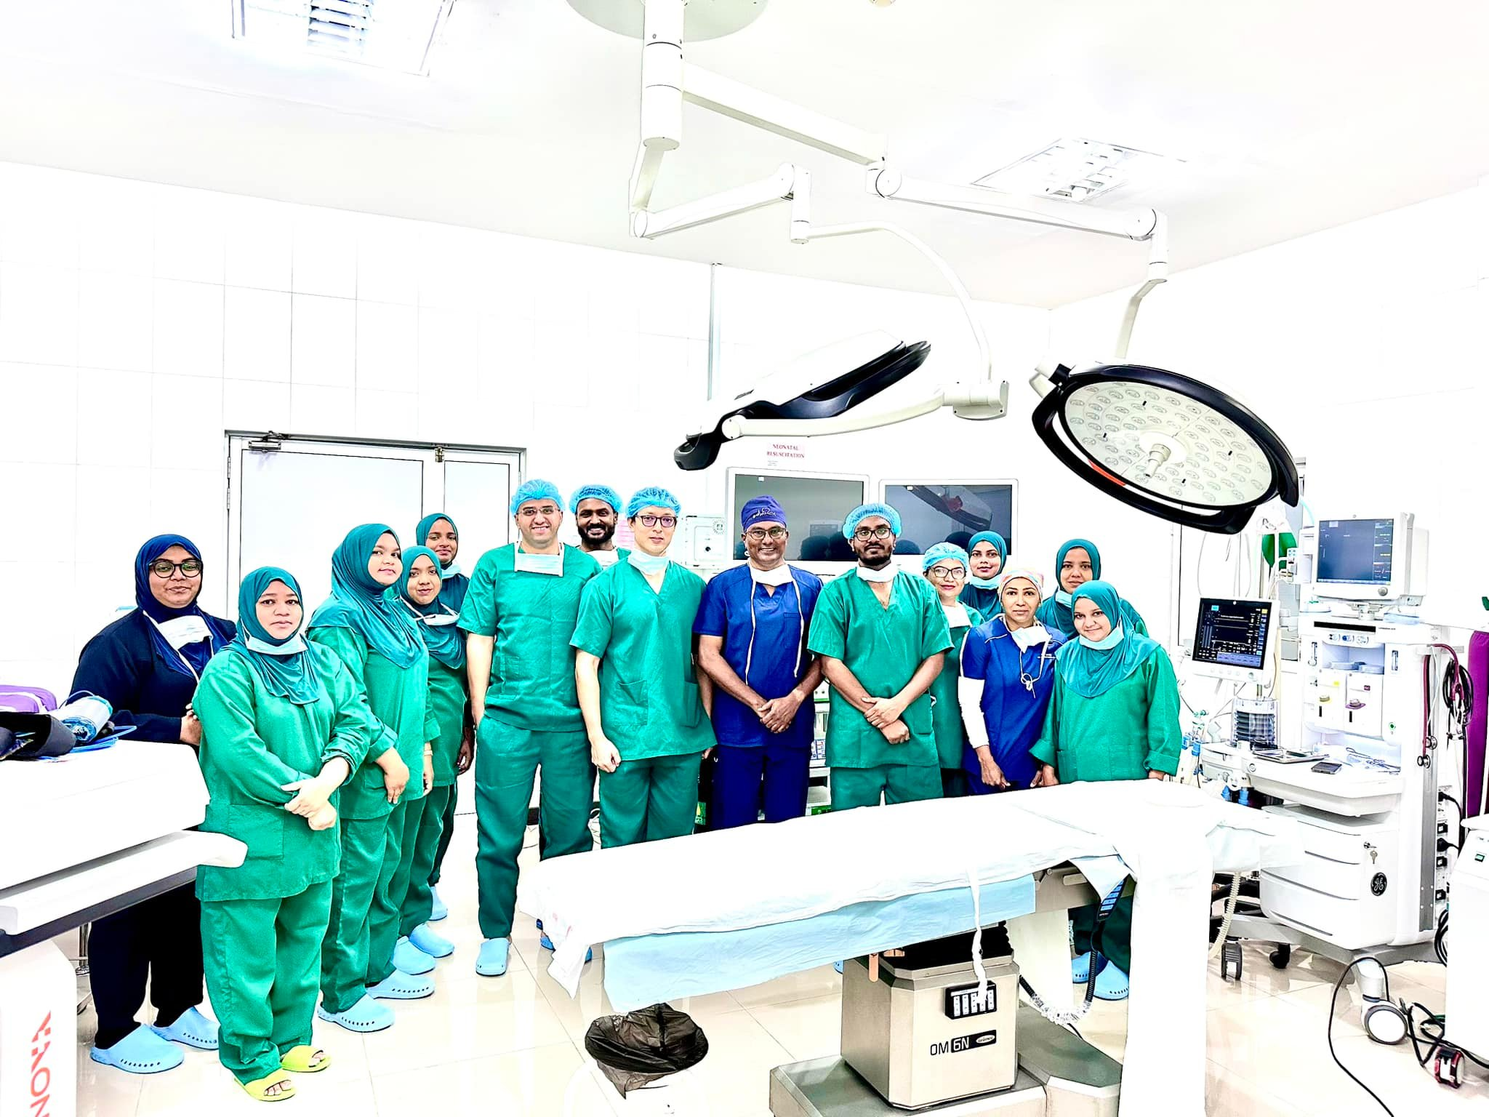
GRH

Slide 16
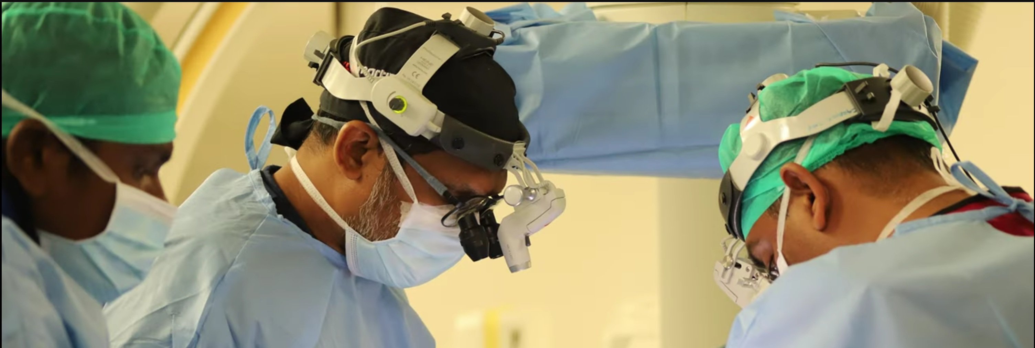
Key Activities of the MAS & Members
3- Development of Surgical Subspecialties
One of the most significant achievements of MAS over the past decade has been the development of surgical subspecialties in the Maldives. When MAS was first established in 2014, there was only one surgical subspecialist, Dr. Mohamed Shafiu, a Cardiothoracic and Vascular Surgeon. Today, we proudly have more than eight surgical subspecialists across six key surgical fields, with many other members currently undergoing subspecialty training.

Slide 17
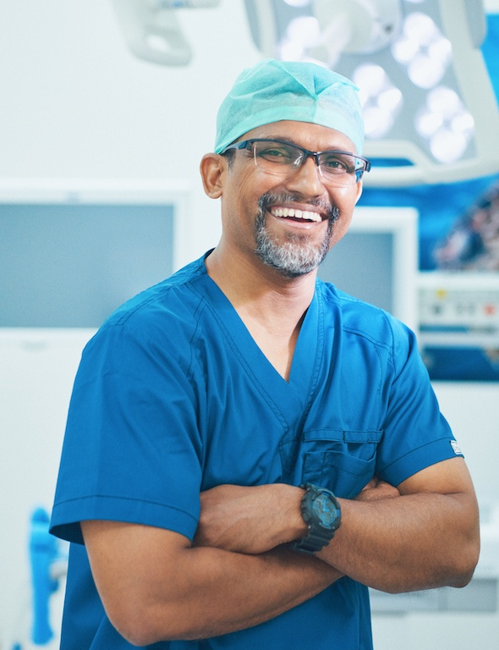
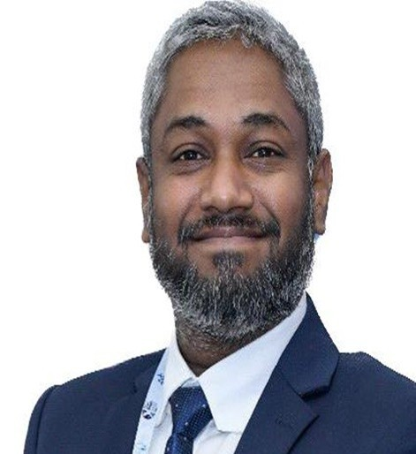
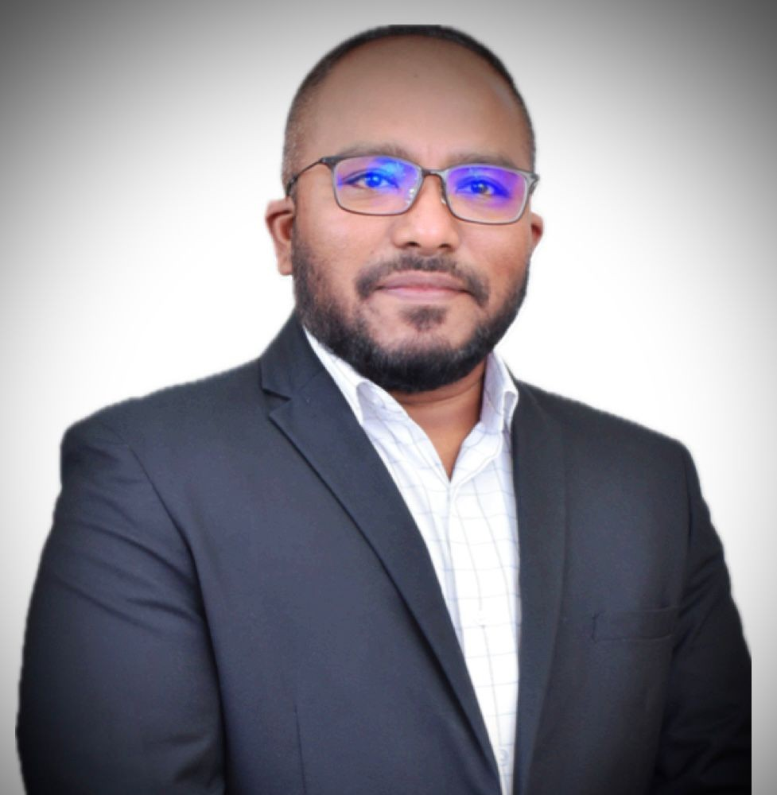
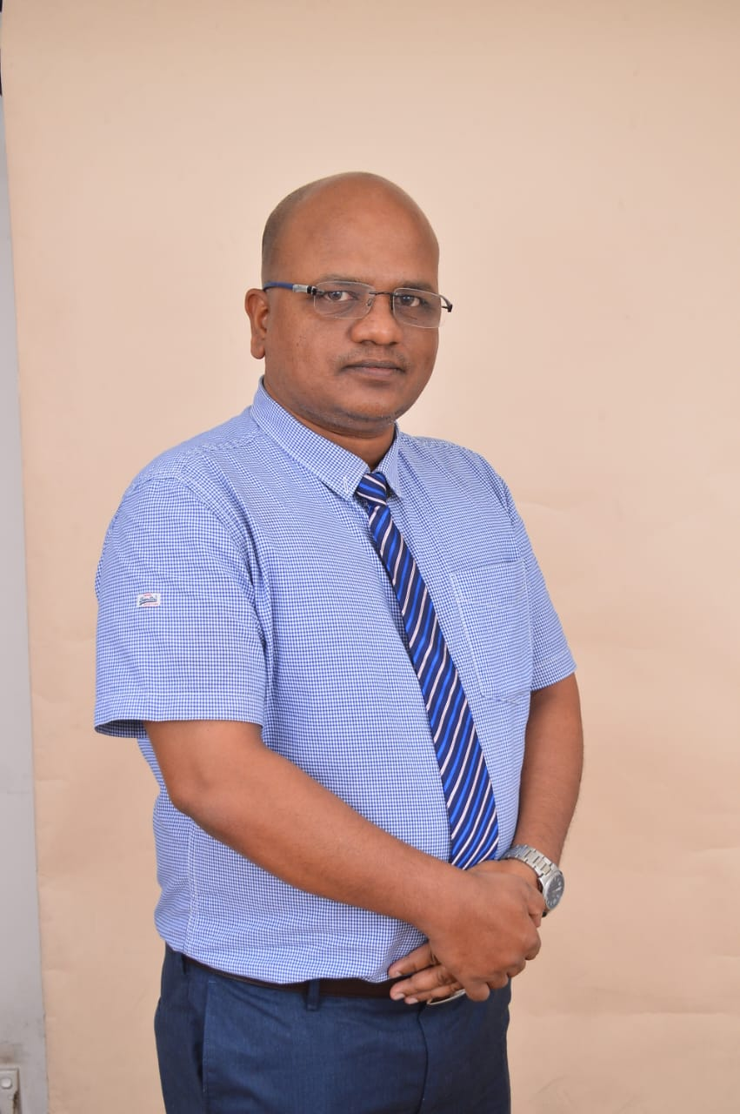
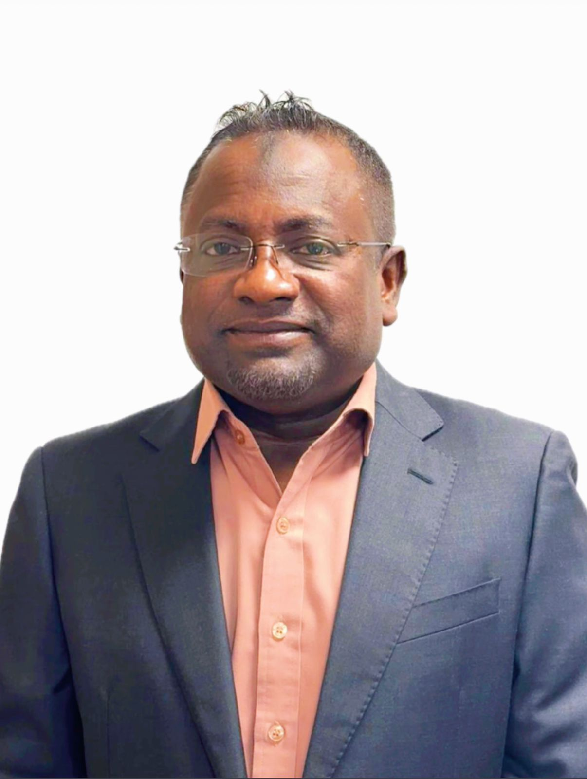
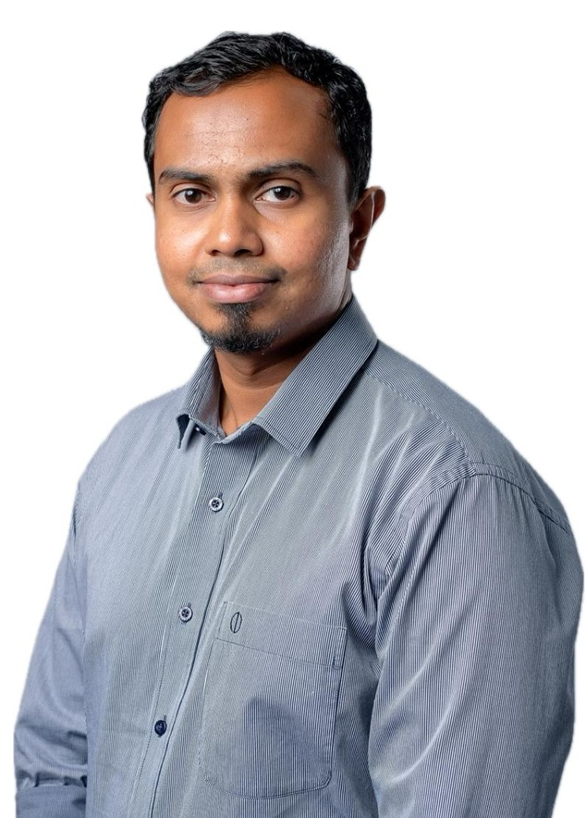
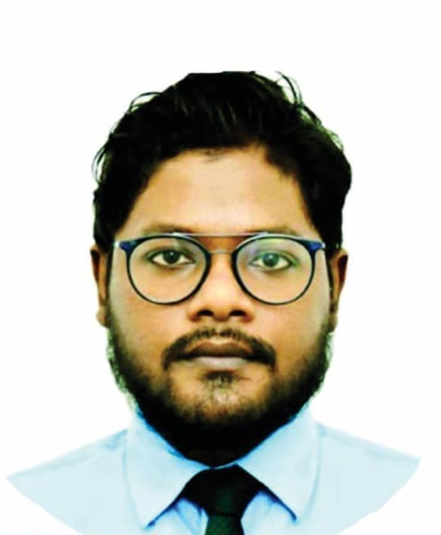

Key Activities of the MAS & Members
3- Development of Surgical Subspecialties
Current Surgical Subspecialties
The surgical subspecialists we are proud to have represent the following fields:
Cardiothoracic and Vascular Surgery
Neurosurgery
Surgical Oncology
Urology
Plastic and Reconstructive Surgery
Surgical Gastroenterology and Metabolic/Bariatric Surgery

Slide 18



Key Activities of the MAS & Members
3- Development of Surgical Subspecialties
Commitment to Excellence
MAS is immensely proud of the expertise, dedication, and contributions these subspecialists bring to their fields. Their work has not only elevated the standard of surgical care but has also paved the way for future advancements in surgical practices within the Maldives.
As we continue to grow, MAS remains committed to supporting the professional development of its members and fostering an environment that encourages specialization, innovation, and excellence in surgical care.

Slide 19



Key Activities of the MAS & Members
4. Academic Activities of MAS and Collaboration with Regional & International Organizations
Since its inception, MAS has been actively engaged in academic and professional development activities, fostering regional and international collaborations to strengthen the surgical community in the Maldives.

Slide 20



Key Activities of the MAS & Members
4. Academic Activities of MAS and Collaboration with Regional & International Organizations
a. Regional and International Representation
  MAS has played an important role in representing Maldivian surgeons on both regional and global platforms. The association has established close ties with SAARC surgeons’ societies, enabling its members to participate in various international forums and conferences organized by prominent surgical societies. Through these collaborations, MAS has enhanced knowledge-sharing and fostered partnerships with leading surgical experts in the region.

Slide 21




Key Activities of the MAS & Members
4. Academic Activities of MAS and Collaboration with Regional & International Organizations
b. Seminars, Workshops, and CME Programs
  MAS has successfully organized numerous academic events, including seminars, workshops, and CME programs. A notable event was the Wound Care Workshop in 2015, which was attended by both local surgeons and international scholars. These initiatives have provided valuable opportunities for skill enhancement and professional growth for surgeons in the Maldives.

Slide 22




Key Activities of the MAS & Members
4. Academic Activities of MAS and Collaboration with Regional & International Organizations
c. Participation in Conferences and Academic Achievements
  MAS members have actively participated in many national and international conferences, where they presented research papers and shared their clinical experiences. Some members have achieved significant academic milestones, earning recognition for their outstanding contributions. Additionally, several senior surgeons have been honored by esteemed universities and foundations with honorary fellowships, reflecting their dedication and excellence in the field of surgery.

Slide 23

Key Activities of the MAS & Members
5. Advances in wound care
Began in 2015
Wound care national conference conducted by MAS, MSWCP and Singapore wound care professional. May 2015
Established a wound care clinic in IGMH

Slide 24
The 1st wound care conference held in the Maldives
Key Activities of the MAS & Members
5. Advances in wound care

Slide 25




Outcomes of AWC in the Maldives
Key Activities of the MAS & Members
5. Advances in wound care
Established AWC services in IGMH
WC/ IGMH- weekly twice
New dressing products
Decreased frequencies of dressing change.
Speed of wound healing increased.
Gained trust and patients satisfaction
Trained staff in GHKL Malaysia
Conducted 4 conferences in 4 regions
Published “wound care manual”
Participated and presented in International conferences
Became member of AWCA and Commonwealth WCRA
Key Activities of the MAS & Members
5. Advances in wound care
Key Activities of the MAS & Members
5. Advances in wound care
Key Activities of the MAS & Members
5. Advances in wound care

Slide 26




Trainings
Key Activities of the MAS & Members
5. Advances in wound care
Conducted 4 training workshops in different regions.
2015- Male region
2016- North (Kulhudhuffushi)
2017- South (Addu)
2018- Laamu
2021- Online conference
2022 – workshop in KRH
2023 – workshop KRH, ASMH,URH,GRH
2024- KRH,ASMH, AEH

Slide 27




MAS is affiliated to all international conferences conducted in MSWCP and D-foot Int.

Slide 28

Key Activities of the MAS & Members
6. Members with Remarkable Achievements
Father of Modern Surgery in the Maldives
Key Contributions:
First Surgeon to Start Surgical Services in the Maldives and considered the father of modern surgery in the country.
Played a key role in the establishment of surgical care in the Maldives, starting from his time in the Central Hospital, where he also served as the chief administrator.
Mentor to all Maldivian surgeons, including current surgical sub-specialists, providing invaluable guidance and training to the next generations of surgeons.
Pioneered advanced surgical techniques in the Maldives, introducing laparoscopic surgery to the country, starting with minimal equipment and limited staff training.
Established endoscopic services, including gastroscopy, colonoscopy, and endoscopic interventions like polypectomies and biopsies.
Leader and fatherly figure of the surgical team until his retirement in 2009, respected and revered by colleagues and trainees alike for his dedication to the surgical field and his vision for modernizing surgical practices in the Maldives.
Impact:
Dr. Firdous’ contributions to the development of surgery in the Maldives are unparalleled. He laid the foundation for modern surgical care and introduced critical advancements that continue to shape the field today. His legacy lives on through the surgeons he mentored and the services he helped establish.
DR. MOHAMED FIRDOUS

Slide 29

Key Activities of the MAS & Members
6. Members with Remarkable Achievements
Key Contributions and Impact:
  A Popular General Surgeon known for his close relationship with patients, ensuring trust and comfort throughout the care process.
  A Key Figure in the Maldivian Healthcare System, with an excellent reputation and the trust of countless patients in his services.
  Perfected Modern Surgical Techniques and performed thousands of procedures, gaining the reputation as the most demanded surgeon in the Maldives until his early retirement.
  Introduced Various Circumcision Techniques, including the bone cutter technique and the Plastibell technique, pioneering these practices in the Maldives.
  Mentor to All Maldivian Surgeons, including surgical sub-specialists, passing on a wealth of knowledge and teaching standard techniques that continue to influence surgical practices today.
  Unforgettable Figure in Maldivian Surgery History, remembered for his exceptional contribution to the development of the surgical field and his lasting impact on the next generation of surgeons.
DR. HAMID RASHEED

Slide 30
Key Activities of the MAS & Members
6. Members with Remarkable Achievements
Chief Surgical Officer (CSO) - ADK Hospital
First Cardiovascular and Thoracic Surgeon of the Maldives
Key Contributions:
First sub-specialist in Cardiovascular and Thoracic Surgery in the Maldives.
Chief Surgical Officer (CSO) at ADK Hospital with over 20 years of experience in the Maldives health system.
Highly skilled in beating heart surgeries, valve repair and replacement, congenital and pediatric open-heart surgeries, aortic and great vessel surgeries, and the management of peripheral vascular diseases.
Proficient in minimally invasive lung and thoracic surgeries.
Played a key role in establishing and sustaining cardiac surgery services in the Maldives, with services highly regarded by Maldivian patients.
Impact:
Dr. Shafiu’s expertise in cardiovascular and thoracic surgery has been instrumental in transforming the treatment of heart and vascular conditions in the Maldives. His leadership and contribution have brought advanced cardiac care closer to Maldivian patients, making a significant impact on the healthcare landscape.
DR. MOHAMED SHAFIU

Slide 31

Key Activities of the MAS & Members
6. Members with Remarkable Achievements
Senior Consultant in Surgery
Previous President, Maldives Association of Surgeons (MAS)
Key Contributions:
Played a key role in advancing laparoscopic surgery in the Maldives, significantly improving the quality and scope of surgical care in the country.
Held leadership positions including Head of Department (HOD) at Indira Gandhi Memorial Hospital (IGMH), Executive Director of IGMH, MD/CEO of Medica Hospital, and CEO of Addu Equatorial Hospital.
Awarded the National Award of Recognition by the President of the Maldives in 2020, in acknowledgment of his outstanding contributions to the healthcare sector.
Received the Certificate of Appreciation from the Indian Association of Gastrointestinal Endo-surgeons (IAGES) in 2018 for his significant contributions to surgical practice.
Honored with a Plaque of Appreciation from the Association of Surgeons of India (IAS) in December 2018.
Conferred the title of Honorary Fellow of the College of Surgeons of Sri Lanka in 2017, recognizing his contribution to the development of surgery in the region.
Impact:
Dr. Mohamed Solih’s exceptional leadership and contributions to surgery, particularly in the field of laparoscopic surgery, have had a profound impact on surgical care in the Maldives. His commitment to surgical excellence and training the next generation of surgeons continues to shape the future of healthcare in the nation.
DR. MOHAMED SOLIH

Slide 32
Key Activities of the MAS & Members
6. Members with Remarkable Achievements
First Neurosurgeon of the Maldives
Senior Consultant Sub-specialist in Neurosurgery, IGMH/DH
Member, Maldives Medical and Dental Council
Key Contributions:
Established and sustained Neurosurgery services in the Maldives, advancing the country’s capacity to treat complex neurological conditions.
Pioneered new techniques in brain and spine surgeries, introducing advanced treatment options that have greatly improved patient outcomes.
First neurosurgeon to introduce endovascular procedures for treating cerebrovascular incidents in the Maldives, providing cutting-edge care for patients with neurological conditions.
Has undergone numerous specialized training programs and attended international conferences, consistently contributing to the development of the field.
Impact:
Dr. Ali Niyaf’s groundbreaking work in neurosurgery has transformed the field in the Maldives. His dedication to advancing surgical practices and improving patient care has solidified his place as a pioneering figure in Maldivian healthcare.
DR. ALI NIYAF

Slide 33
Key Activities of the MAS & Members
6. Members with Remarkable Achievements
First Surgical Oncologist in the Maldives
Director, National Cancer Center
Vice President, Maldives Association of Surgeons (MAS)
Key Contributions:
Established and sustained oncology services in the Maldives, making cancer treatments widely accessible. Today, all types of cancer treatments, except radiation therapy, are available locally.
Played a crucial role in alleviating the suffering of cancer patients by providing comprehensive cancer care within the country.
Led nationwide cancer screening programs, visiting all inhabited islands of the Maldives with his Cancer Society team to promote early detection and awareness of cancer.
Currently serving as the Vice President of MAS, actively contributing to the growth of surgical services and cancer care in the nation.
Impact:
Dr. Shifan’s remarkable work in establishing oncology services has transformed cancer care in the Maldives. His dedication to improving patient outcomes and raising cancer awareness is commendable, making him a key figure in healthcare development.
DR. MOHAMED SHIFAN

Slide 34

Key Activities of the MAS & Members
6. Members with Remarkable Achievements
Senior Consultant in Surgery – Chief Surgical Officer, ADK Hospital
Key Contributions:
Underwent advanced Minimally Invasive Surgical Training at World Laparoscopy Hospital, Gurgaon, India, securing first position in his batch.
Pioneered Single Incision Laparoscopic Surgeries in the Maldives, introducing advanced surgical techniques that have transformed surgical practice in the country.
Played a leading role in introducing and expanding Minimally Invasive Surgery across various surgical fields, setting new benchmarks in patient care.
Successfully established and sustained Bariatric Surgery services in the Maldives, performing numerous complex procedures and improving health outcomes for patients with obesity and related conditions.
Impact:
Dr. Ahmed Nishan’s efforts in advancing laparoscopic and bariatric surgeries have been pivotal in elevating surgical care standards in the Maldives. His dedication to surgical innovation and patient-centered care has left a lasting impact on the Maldivian healthcare system.
DR. AHMED NISHAN

Slide 35
Key Activities of the MAS & Members
6. Members with Remarkable Achievements
First Subspecialist in Plastic and Reconstructive Surgery in the Maldives
Current Executive Secretary of the Maldives Association of Surgeons (MAS)
Key Contributions and Achievements:
Leadership in MAS: Serving as the current Executive Secretary of MAS, Dr. Waheed has been instrumental in advancing the field of surgery across the Maldives, shaping its future and guiding the development of surgical care.
Department Head at IGMH/DH: As the Head of the Department of Surgery at Indira Gandhi Memorial Hospital, Dr. Waheed leads the surgical team in providing world-class care, shaping surgical practices and training future generations of surgeons.
Pioneer in Advanced Wound Care: He established and introduced advanced wound care services across the Maldives, revolutionizing the way wound management is approached in the country.
International Leadership in Wound Care: Chaired the International Conference on Wound Care held in the Maldives in 2015, and is a member of global wound care societies, sharing best practices and innovations.
Mentorship and Training: Dr. Waheed is known for his dedication to mentorship, having trained and guided numerous surgeons in the Maldives, impacting the country’s surgical standards.
Impact
Dr. Waheed has significantly advanced surgical care in the Maldives, particularly in plastic and reconstructive surgery. His contributions to wound care and leadership within MAS have improved healthcare standards, while his mentorship has shaped the next generation of surgeons, leaving a lasting impact on the country’s healthcare system.
DR. MOHAMED WAHEED

Slide 36

Key Activities of the MAS & Members
6. Members with Remarkable Achievements
Senior Consultant in Surgery – IGMH/DH
President, Maldives Association of Surgeons (MAS)
Key Contributions:
Served as Head of Surgery Teams in leading hospitals, including IGMH, ADK, and TreeTop Hospital, contributing to the advancement of surgical services.
A pioneer in Minimally Invasive Surgery (MIS) in the Maldives. Led the introduction of MIS in four regional hospitals—Kulhudhuffushi Regional Hospital (KRH), Abdul Samad Memorial Hospital (ASMH), Ungoofaaru Regional Hospital (URH), and Gan Regional Hospital (GRH)—extending advanced surgical care to 80% of the country.
Actively involved in surgical research, with the first surgery field research conducted at IGMH expected to be published soon.
Recipient of the prestigious Honorary Fellowship Award from the Indian College of Laparoscopic Surgery in 2024, in recognition of his contributions to minimally invasive surgical practices.
Impact:
Dr. Abdulla Ubaid’s leadership and dedication have significantly contributed to improving surgical care across the Maldives, making advanced surgical techniques accessible in peripheral regions and elevating the overall quality of healthcare.
DR. ABDULLA UBAID

Slide 37

Key Activities of the MAS & Members
6. Members with Remarkable Achievements
Minimally Invasive and Breast Surgeon
First Maldivian Female Surgeon
Key Contributions:
• Specialized in Breast Surgery, with advanced training in managing breast conditions.
• Executive Council Member of the Asian Society of Mastology (ASOMA), India, representing the Maldives on a prestigious international platform.
• Founded the Breast Clinic at TreeTop Hospital, introducing a novel and highly efficient model of care in the Maldives.
• 70% of patients complete case registration, clinical evaluation, imaging, biopsy, and report evaluation in a single sitting, significantly improving patient outcomes and convenience.
• Pioneer in promoting Minimally Invasive Surgery for breast conditions in the country.
Impact:
Dr. Neeza Haleem’s work has set a benchmark in surgical care, particularly in breast health, bringing world-class services to the Maldives and ensuring timely and efficient care for patients.
DR. NEEZA HALEEM

Slide 38


Conclusion
The Maldives Association of Surgeons (MAS) takes immense pride in its activities and the significant contributions made toward the development of surgical care in the Maldives over the past decade.
Our efforts have had a lasting impact, and we remain steadfast in our commitment to further enhance surgical services in alignment with national healthcare policies and strategic plans.
MAS looks ahead with optimism and a renewed sense of purpose, determined to support the ongoing progress of surgical care in the Maldives and contribute to the global surgical community

Slide 39

Thank You

